Slide 1


Introduction
To The Study
Of History
From an Islamic perspective
http://www.com
http://www.com

Slide 2
01
Introduction
History is knowledge, and knowledge is a journey. What do we need before setting on this journey?
………………………………………
02
Know your intention
Step1: Set your intentions to study History.
……………………………….
Topic Covered
03
What is History?
Step 2: Know your destination: You want to know about History.
………………………………………
04
Why study History
Step 3: Why are you on this journey?
………………………………………
05
The 5 steps to reach Knowledge
Step 4: The steps to take to reach your destination. …………………………

Slide 3
باسم الله الرحمان الرحيم
Praise be to Allah ,the praise of thankful people and prayer and peace of Allah be upon Mohammad the last of prophets and Imam of messengers and upon all the companions and followers and who follow them charitably to the hereafter and we bear witness that there is no God but Allah, alone with no partner, God of first and last, witness by which we wish to escape in the hereafter and we bear witness that Mohammad is his servant and messenger. We ask (pray) the almighty God that teachers, fathers , mothers and students benefit from this course and makes what in it purely for the sake of almighty God .

Slide 4





Before you set on any journey you need to:
know your destination
Why are you on this journey?
And the steps it take to reach it
Set your intention

Slide 5


Well! Studying History is a Knowledge,
And Knowledge Is A Journey!
While Seeking knowledge is a noble pursuit for a believer, we often miss out on maximizing the reward for this deed because we do not know how to make the right intention”s”.

Slide 6
So how did the companions ra dealt with their intentions?
It was said that the companions were business men with their intentions, they had several intentions for one single deed , trying to have mountains of reward collected in their book of good deeds with a single transaction.

Slide 7

And how can we improve ours?
If we consciously ponder upon the intentions behind our actions and try to have them present before we start gaining any knowledge (ie: Enrolling in a course, attending a class, or listening to a podcast or lecture ect...) we will no doubt reap more rewards for our actions and see the difference in the quality and quantity of information we absorb and remember.

Slide 8
Step 1
Set your Intentions

Slide 9

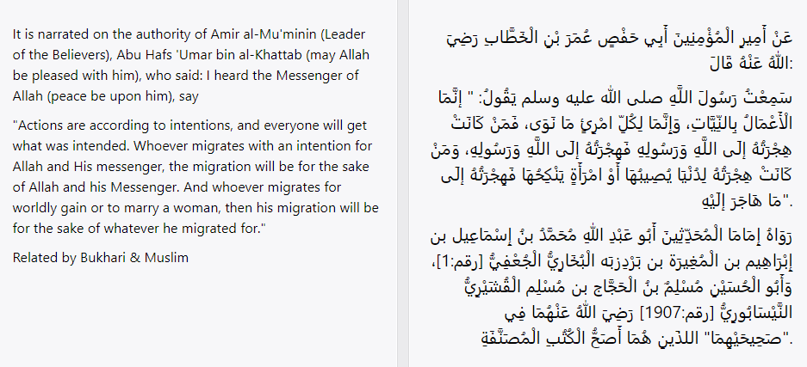

Actions are by intentions
Many scholars began books with this hadith
Action 1:
Copy down this hadith in your best hand writing in your copywork book and try to memorize it.
Notes:
Hala: This Hadith is to be copied in their best hand writing and memorized (as an extra activity) We will need to write later in the how to teach this course the wisdom of memorizing and copying down what they learn. All along the course we will be giving them quotes from : 1-Quran, 2-Hadith, 3- famous personalities sayyings. Therefore we will have a separate work book to write down their narrations.

Slide 10


Write down your Intentions
Action 2: Write a list of the intentions you have from studying History. See how many you can come up with.
Intention 1
Intention 2
Intention 3
Intention 4
Intention 5 …ect
Notes:
Hala: List of suggestions for parents added on a separate document document to help their students in their first exercise. They will make a list of possible intentions they would like to be rewarded for while studying History and we will provide them with a nice template to decorate, fill with their intentions, print, laminate and stick to their wall while they study. We might aske them to go back from time to time to renew their intentions or add to it.

Slide 11
Step 2
Know your destination

Slide 12

We want to learn about History
So What is History?

Slide 13


﴿ قَدْ خَلَتْ مِن قَبْلِكُمْ سُنَنٌ فَسِيرُوا فِي الْأَرْضِ فَانظُرُوا كَيْفَ كَانَ عَاقِبَةُ الْمُكَذِّبِينَ﴾
[Quran 3:137]
Many were the Ways of Life that have passed away before you:
travel through the earth, and see what was the end of those who rejected truth.
“History doesn’t require a teacher, it only requires a foot that walks, an eye that sees and a heart to understand”
Abdel Aziz Al Tarifi
Take a few minutes to think
to yourself about what this
means. Write down your
thoughts.
Notes:
Tafseer of this Ayah…
What do you understand from this quote?
Ayah Number to add on card stocks for copy work.

Slide 14

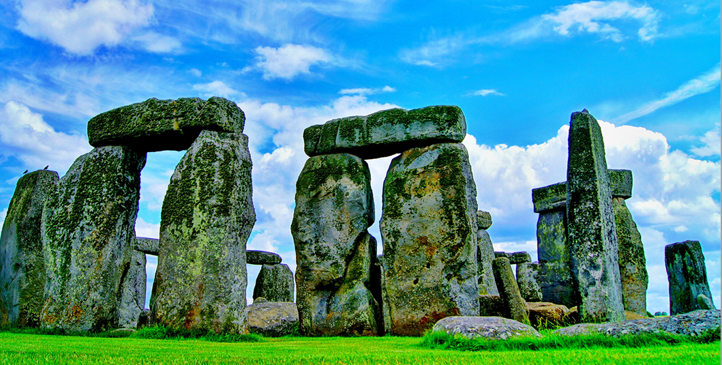
They say, people that do not have a history do not exist, since in it are the foundations of nations, they live with its presence and die without it.
Take a few minutes to think
to yourself about what this
means. Write down your
thoughts.
Stonehenge’s Rocks
Notes:
What does this quote mean?

Slide 15
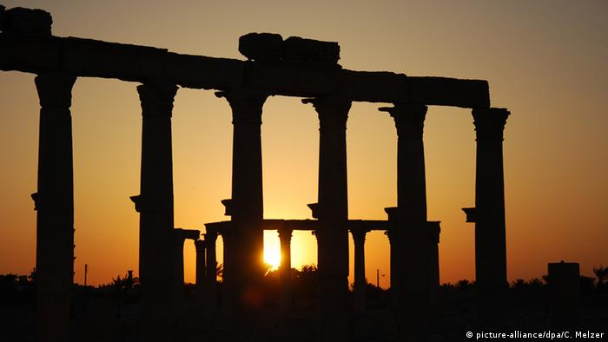

So what is History?
History = Greek ἱστορία, historia.
Meaning= inquiry; knowledge acquired by inquiry or investigation.
History is the study and the documentation of the past, particularly Human affairs.
Notes:
What is History in your own words ( Summary Worksheet).

Slide 16
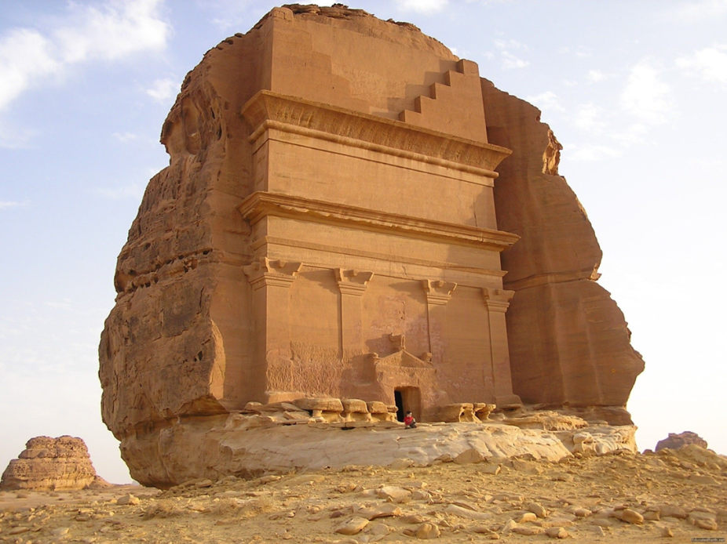
History study doesn't mean just looking at facts and historical events that have passed on man since his creation by God to this day, but it means more an in-depth analysis of these events trying to come up with lessons to enlighten man in his current time and place he lives in.
Hegra Mada’in Saleh

Slide 17
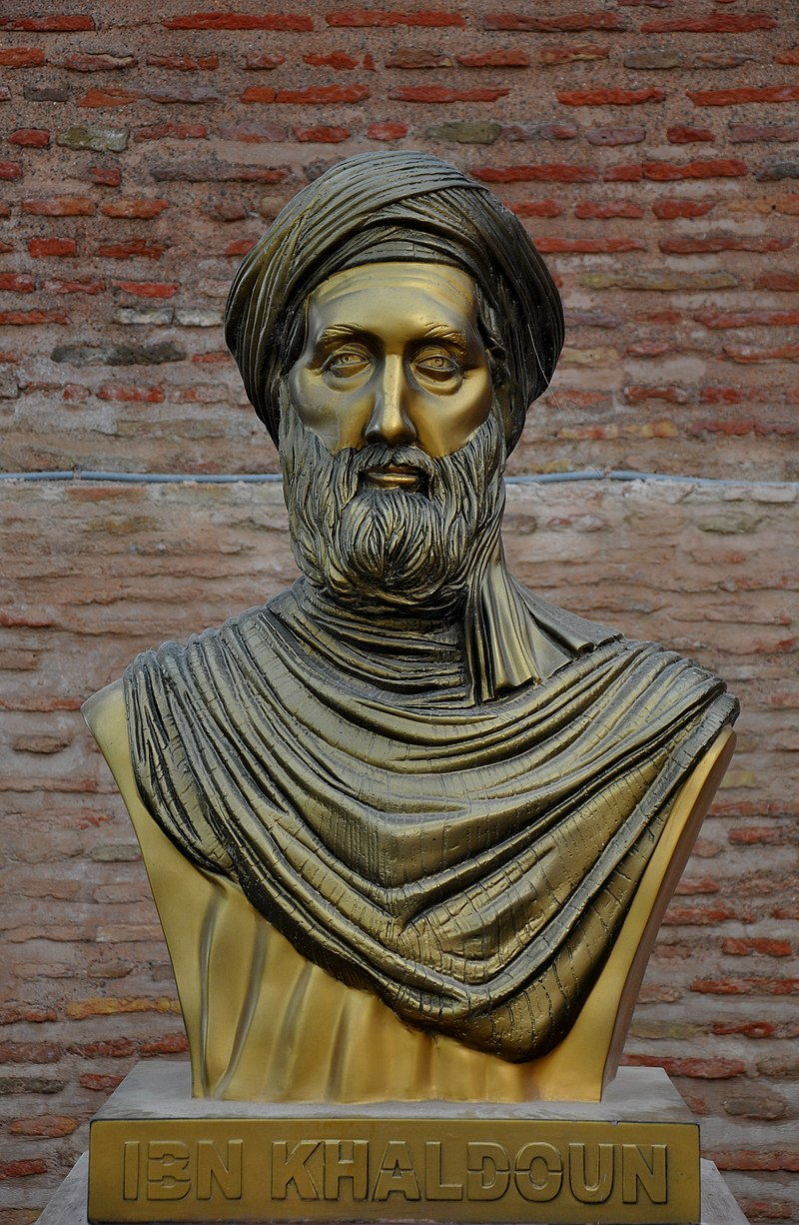
Ibn Khaldun in His Muqaddimah said:
“History is not a collection of stories recounted for the sake of amusement and entertainment as some people believe it might look outwardly”
“Since it appears to be nothing more than news about days and states, but in reality there is an examination, investigation and explanation of historical events and figures as well as understanding of the modalities of the facts and their causes. Source: المقدمة 1/282
Take a few minutes to think to yourself about what this means. Write down your thoughts.
Notes:
What is The Muqaddimah? A research page on it+ a biography of Ibn Khaldun.

Slide 18

The meaning of History
Tale
The first meaning of history is "tale, story,"
Chrono (GK)=time
The second meaning is "a chronological record of significant past events."

Slide 19
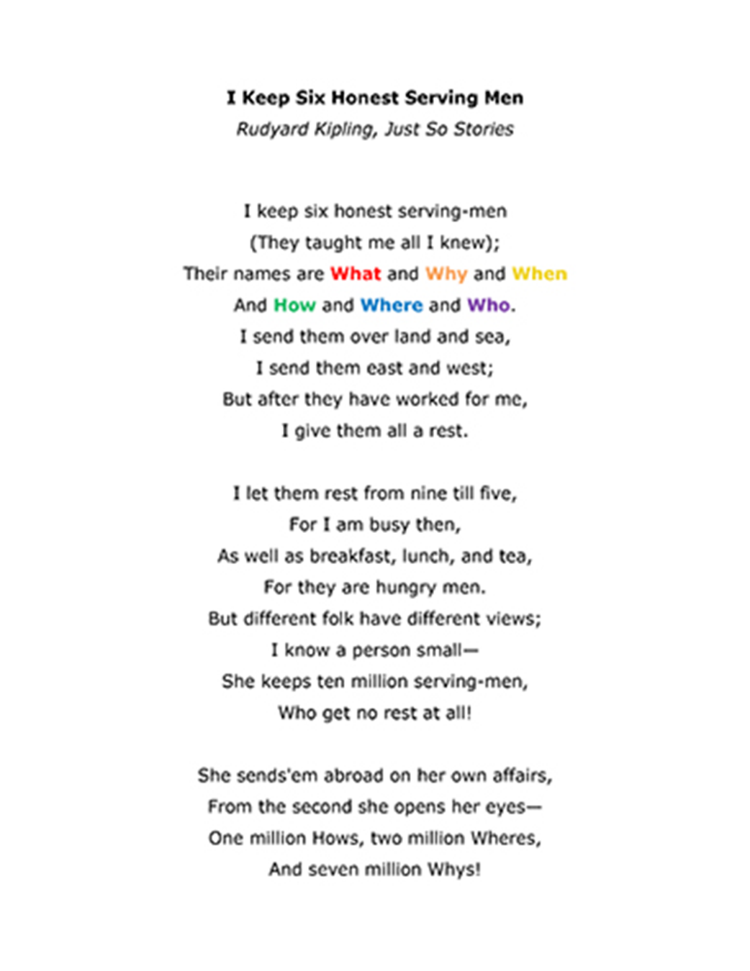
History answers 6 questions
What ?
01
Why ?
02
When ?
03
How ?
04
Where ?
05
Who ?
06
Notes:
Copy and Memorize Kipling’s poem
Exercise of the 5 W’s

Slide 20
Step 3
Why are you on this journey

Slide 21
Why Study History?

Slide 22

1- Because History repeats itself
There is Hardly an incident that does not have an analogue in history and it is unfortunate to see the mistakes of history being repeated due to ignorance of it.
Whoever is ignorant of history must repeat its mistakes, and most people fall into the same pits of the past.

Slide 23
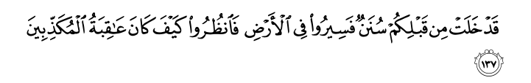
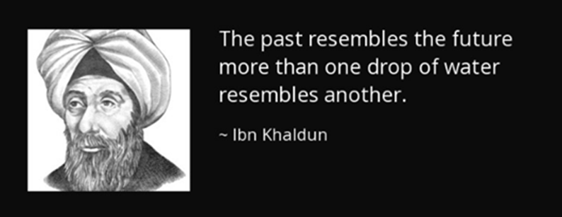
The wheel of history and its events have similar beginnings and ends, yet humans repeat the same mistakes.
Similar situations [as yours] have passed on before you, so proceed throughout the earth and observe how was the end of those who denied.
Al Imran 3:137
Contents Title
The Wheel of History
Notes:
Ayah Number to add on card stocks for copy work.

Slide 24






2- The 1/3 of the Quran is stories
History is important especially for us Muslims
If we look in the book of Allah swt, there is something amazing!
We find that the third of Al Quran is stories!
And why was it sent down? Isn’t for teaching us?
So it is a divine method to teach through story telling. A unique “Godly” style of educating! And teaching!
Quran

Slide 25


1
Prophets
Sent to different people all the way from the first Man Adam pbuh.
Stories In the Quran
Talk About
2
Righteous people
The people of the Cave, the people of the trench, Luqman the wise, Al Khudhr…ect
Destroyed Nations
3
Saba’, people of A’d, Thamud and Lut…ect
4
Evil doers
Fir’awn, Qarun, Nimrod, Abu Jahl…ect
Notes:
Ayah Number to add on card stocks for copy work.

Slide 26
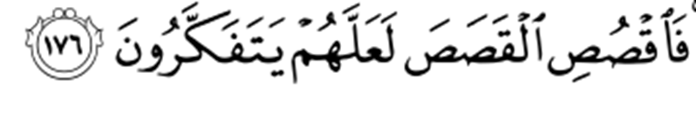

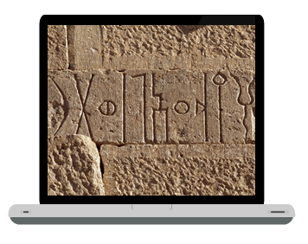
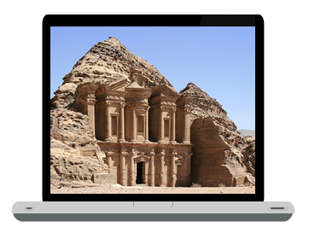
So when we read stories in general, and learn about history in particular, It has to be done with the intention of doing it for:
Thinking =Reflecting =Pondering=Thinking=Analysing
3- To Reflect and Ponder
So relate the stories that perhaps they will give thought.
Al A’raf 7:167
We do not study
History just for fun
The sluices of the Great Dam of Marib
The Nabatean city of Petra
Notes:
Definition of Tadabbur. Indept looking at things that will render them so known that it allows you to see their back (dubur).

Slide 27


4- To Increase your Eman
Perhaps one of the most obvious benefits of studying History is Knowing the news of the prophets and messengers, and this benefit increases your faith, for belief in the messengers is their knowledge, and reading what has been narrated about them is among the relevant reasons for that.

Slide 28
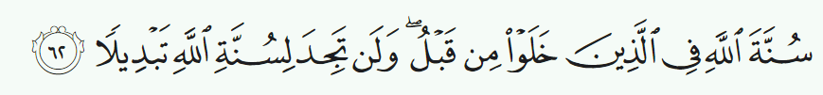





5- To Learn the Sunan of Allah in the creation
This has been God’s practice with those who went before. You will find no change in God’s practices.
Al Ahzab 33:62
In History we learn that Allah swt has ways in the creation.
The ways of Allah are fixed
The Sunan of the creation don’t change
Notes:
Sunnah = the way, the road, the practice

Slide 29



The Sunan of the creation
Example 1
Example 2
Example 3
Example 4
Water boils at 100
Fire burns till the end of times
Can we live without food?
Sharp knives always cut
And it will do so until the end of times. If water boils at 30 today and 60 tomorrow we will have hard time living on earth.
That is the rule. Imagine not knowing what temperature burns?
Again, is there an exception?
Can Think of one?
No one can live without food. Can you think of an exception?
It is dangerous to play with sharp objects because we know they can cut your skin. What was the exception for this Rule?
°C
Notes:
Hint for question 1: Who was thrown into the Fire? And what happened to him?
Hint for question 2: Who were the people who slept for so long they didn’t eat or drink?
Hint for question 3: Who was to be sacrificed by his father? And What happened when the knife was on his neck?

Slide 30

What do we learn from the Sunan of the creation?
The ways of Allah swt in changing the nations are fixed
Dr.Ragheb Sirjani
The wise one will repeat what the righteous did in the past and avoid the actions of the wrongdoers.
The successful believer doesn’t fall in the same trap (mistakes) his predecessors fell in!
When we study History, we should always ponder about the ways of Allah swt. When you follow these steps, it will lead you to these results but if you take another path then the results will change.
History amazingly repeats itself, so when you read History it is as if you are reading the future.
The sunan of Allah swt in the creation are fixed to make life predictable for human beings, and therefore we should not build on the exceptions in the previous examples as they are their to teach us that the power of Allah is beyond the ordinary and to rely on Him alone!
Allah swt with his ways described in the Quran

Slide 31
Step 4
The steps it takes to reach your destination

Slide 32

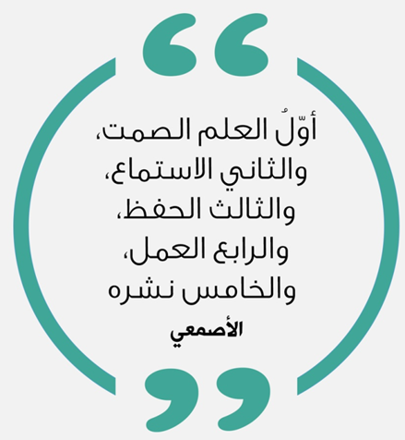

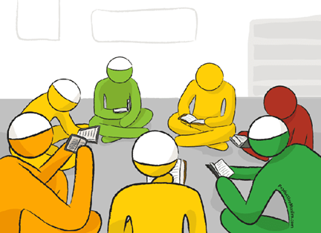
The 5 Steps to reach Knowledge
By: Imam Al-Asma‘i* (740-828CE)
5th step
4th step
Is to spread and teach it
3rd step
Is to apply it
2nd step
Is to memorize it
1st step
Is to listen
Is to keep Silent
Notes:
Craft: Make a banner in your study room to remind you of these important steps to gain knowledge.
A biography of Al Asma’i

Slide 33
Let’s begin this wonderful journey, and get ready to be fascinated with the History of mankind…
Inshallah

Slide 34
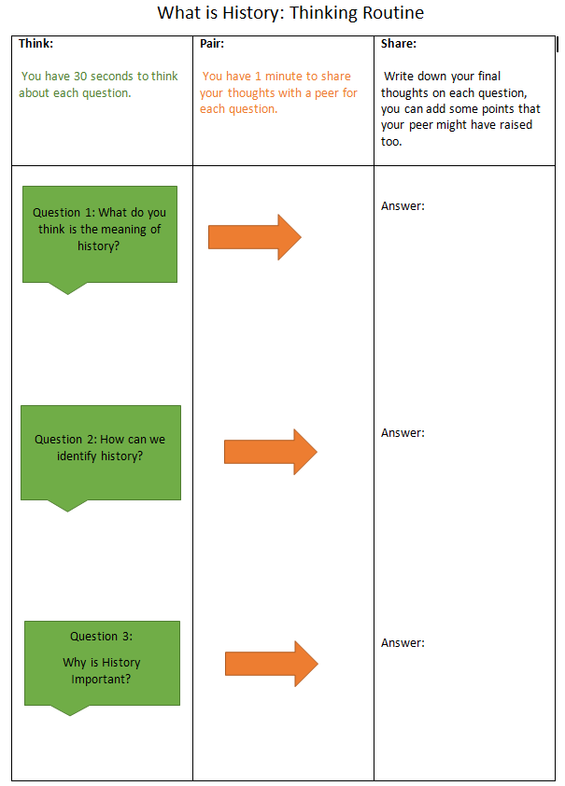

Slide 35

Summary
After finishing the introductory presentation, can you summarize what you have learned so far about what history is and why do we need to learn it? Try to prove your point with a Quran verse and a quote.
A Quranic Verse
Point 3
Point 1
History
Point 4
A quote
Point 2
www.free-powerpoint-templates-design.com

