Slide 1
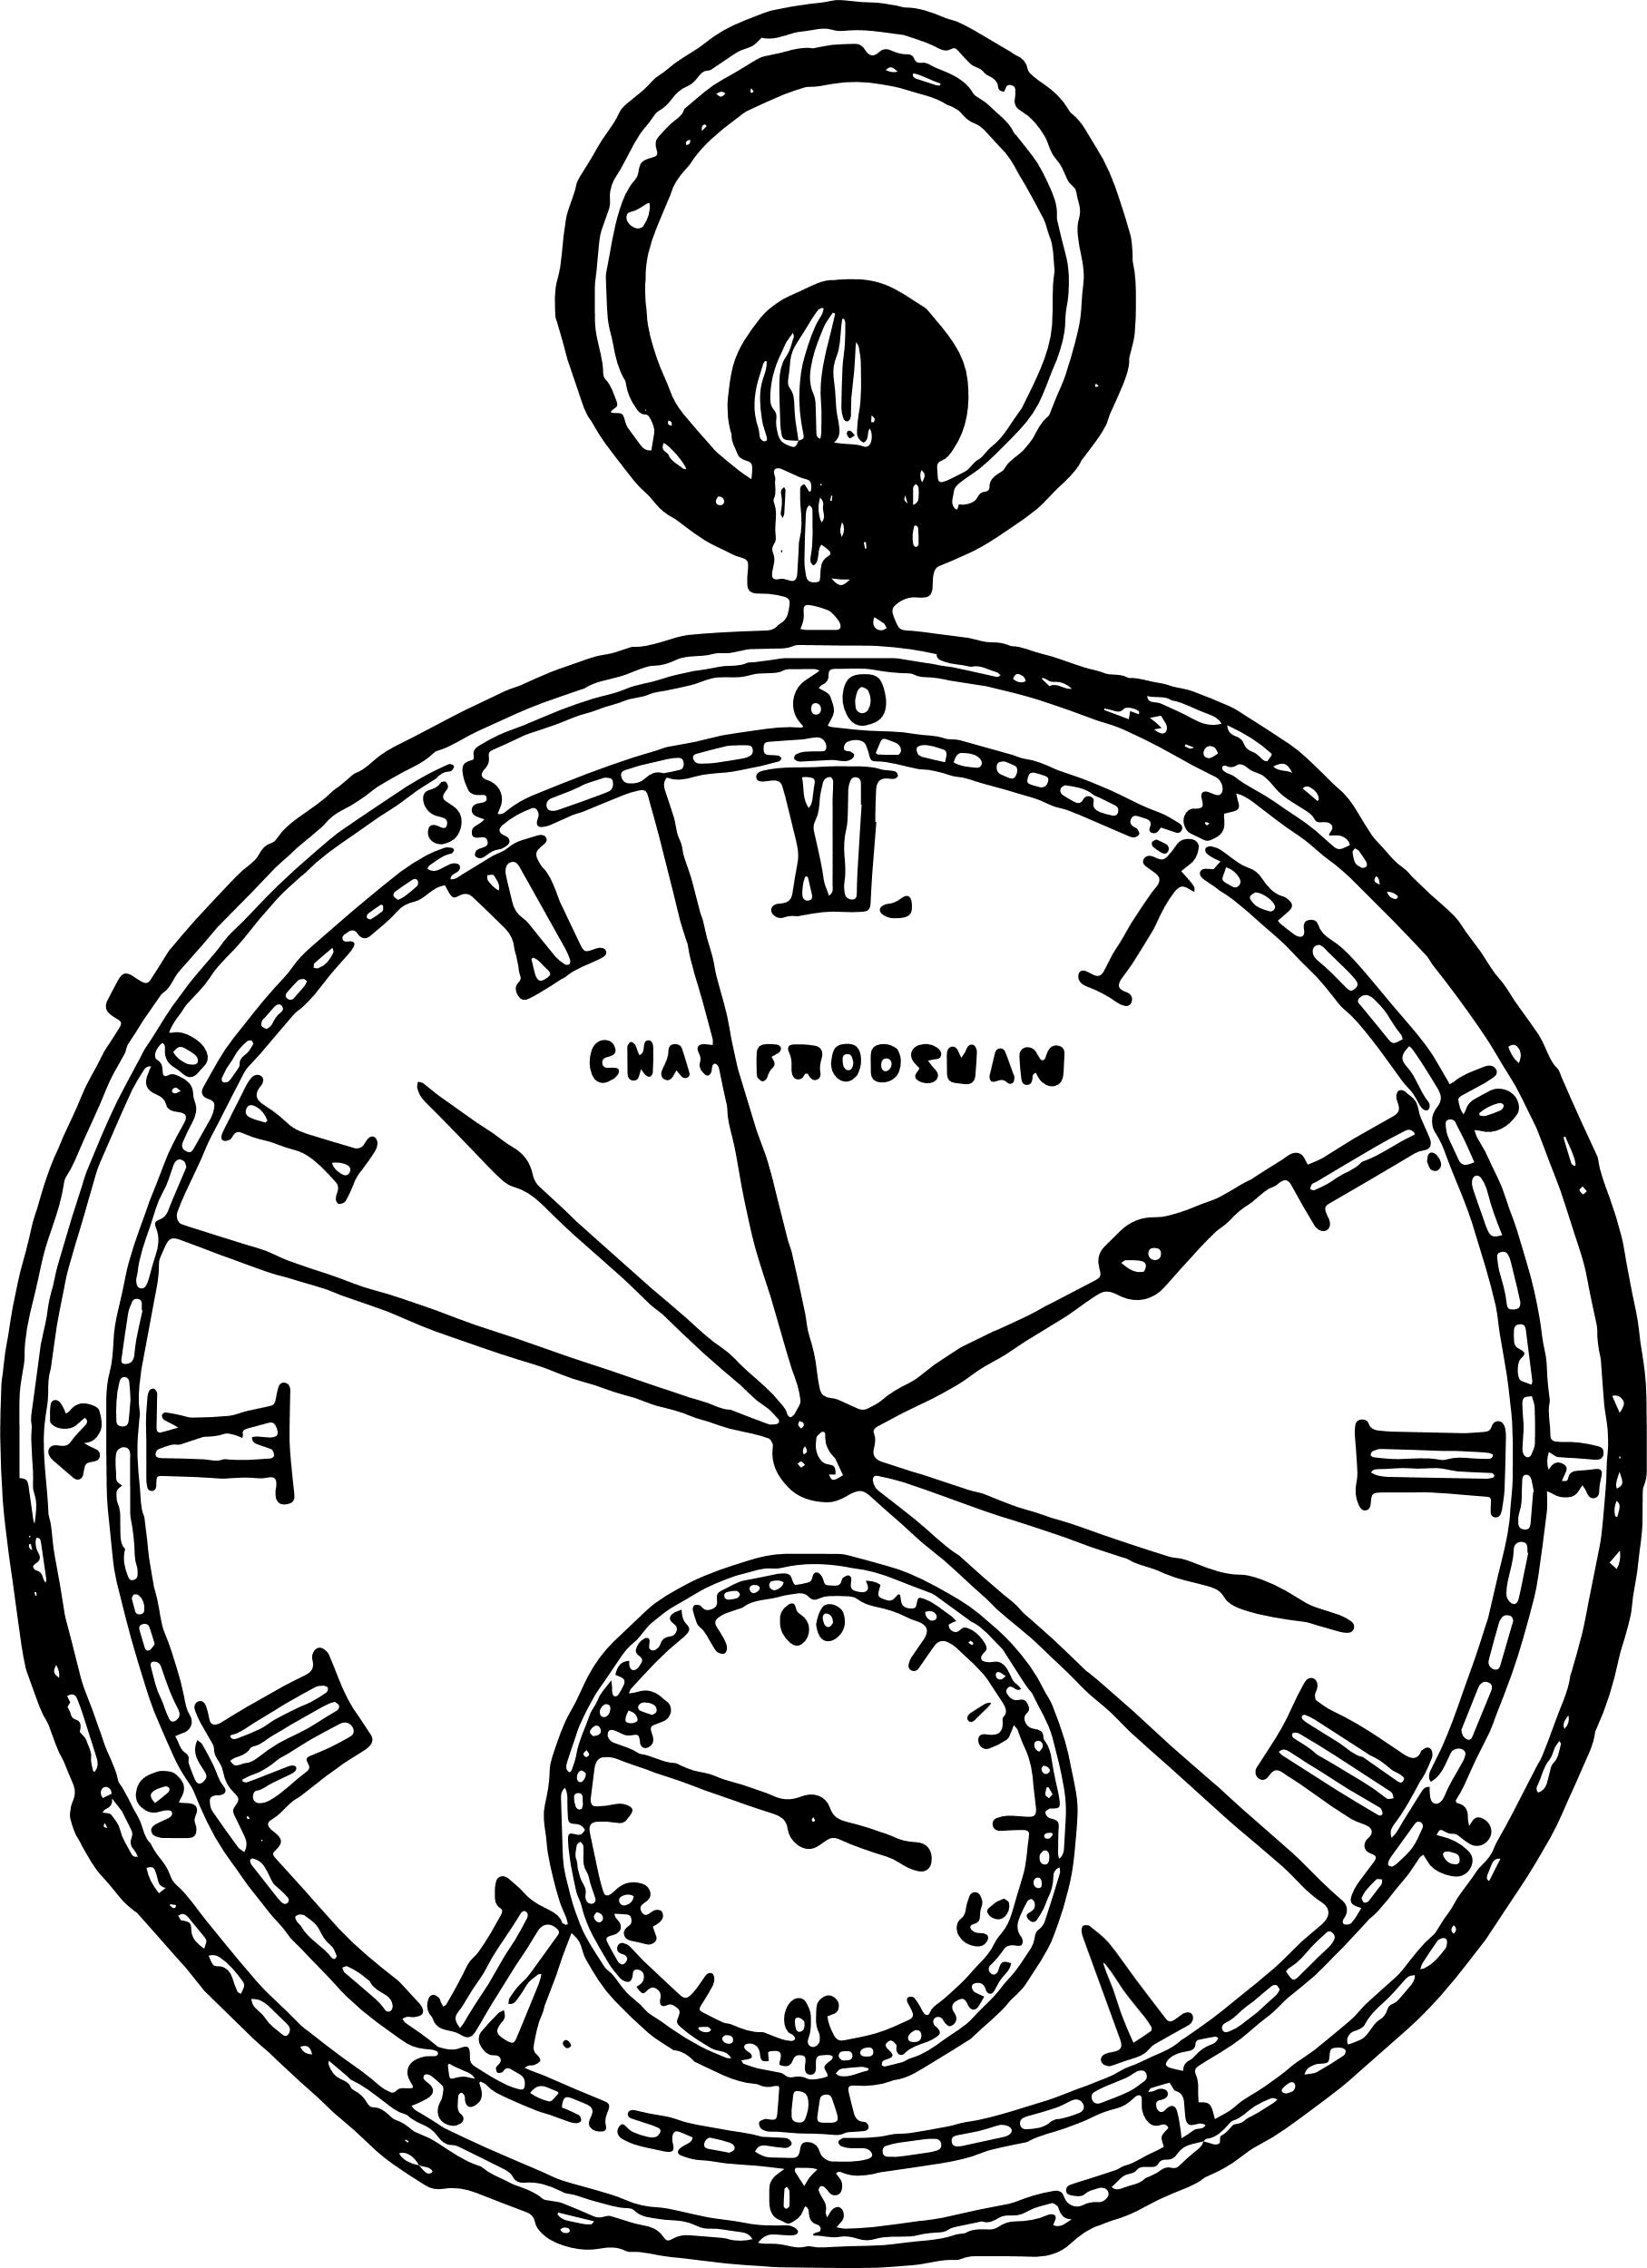
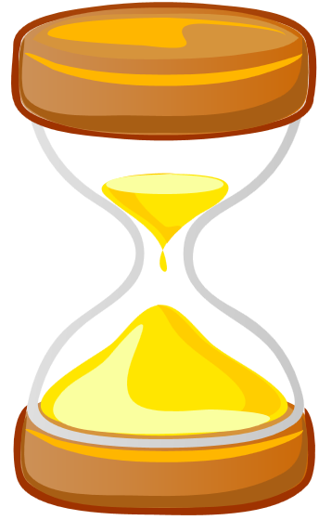
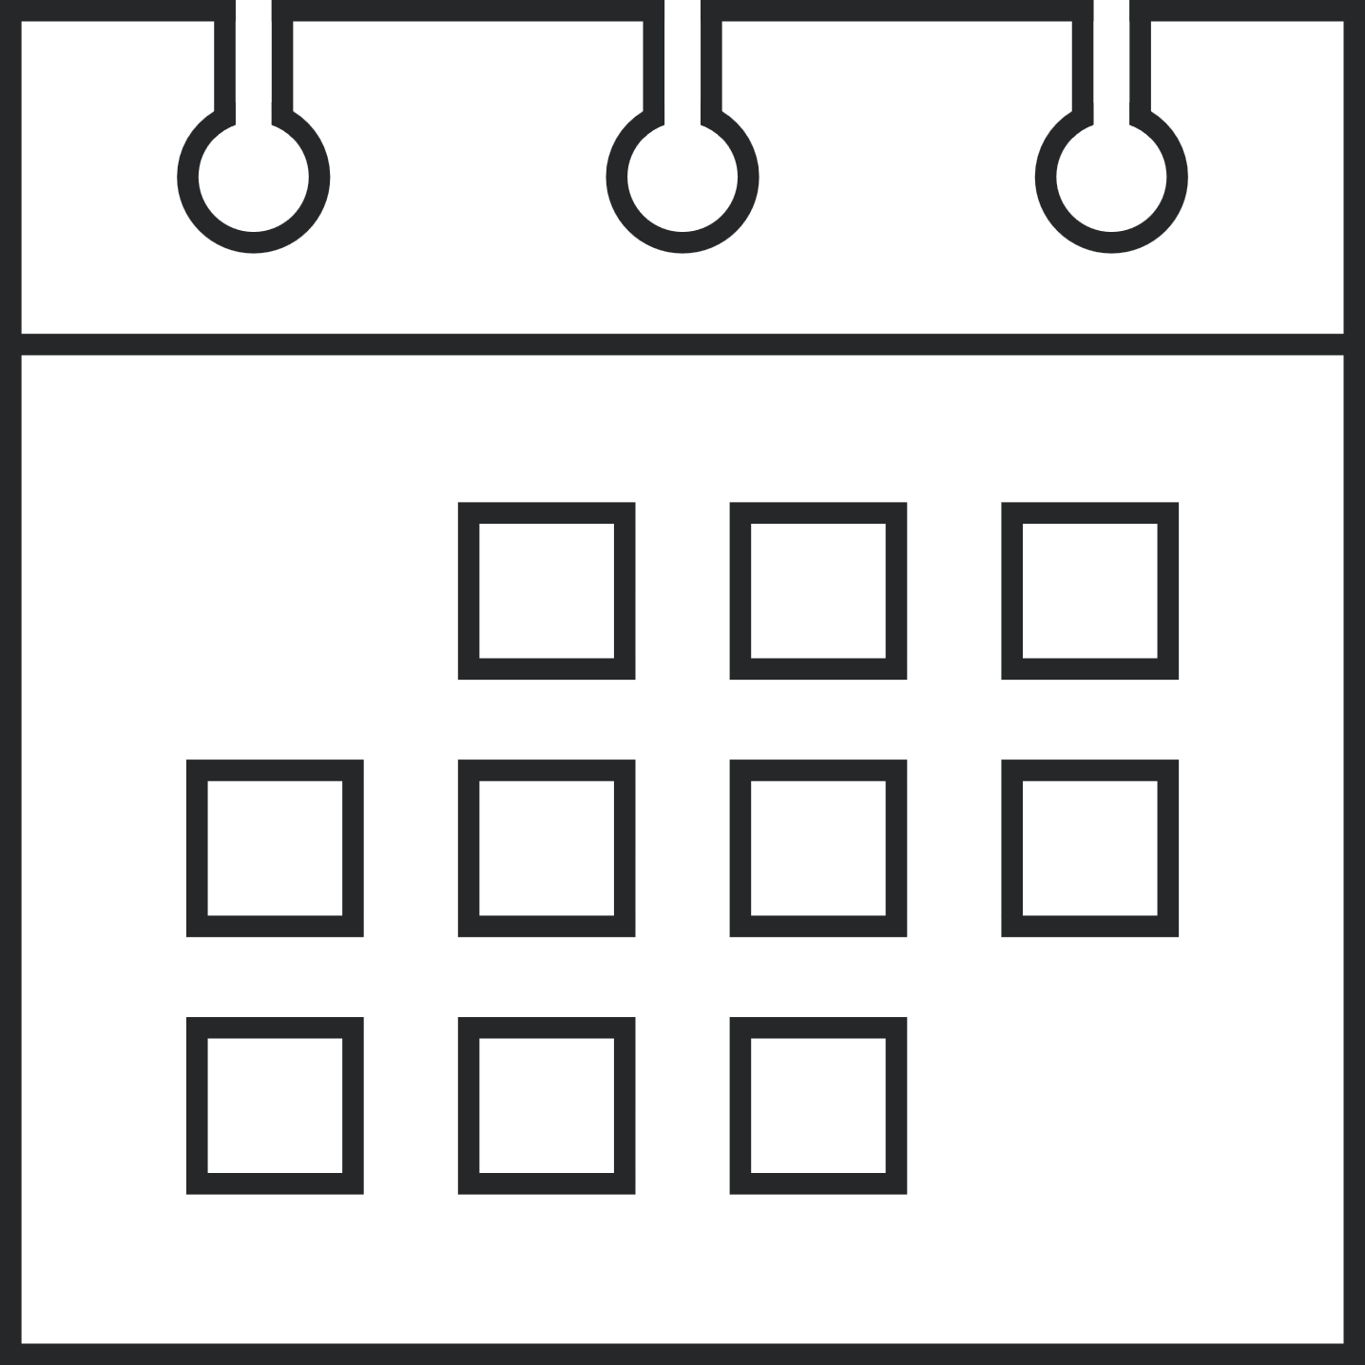
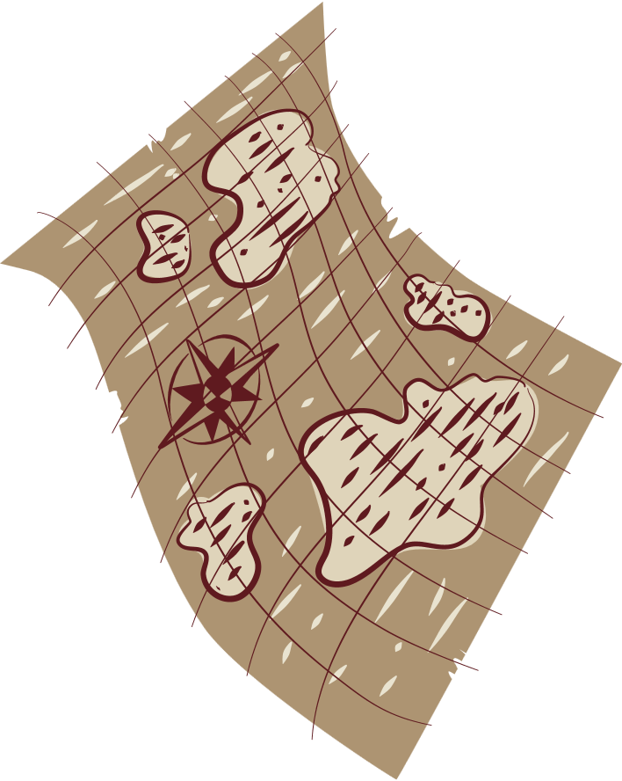

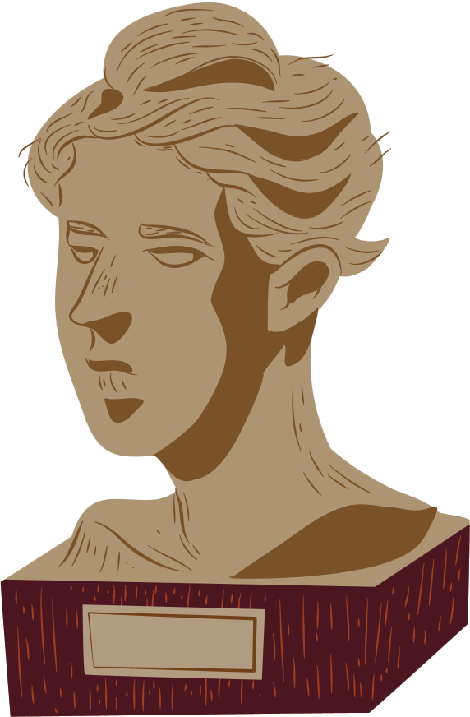
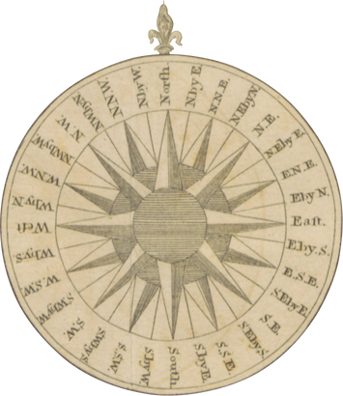
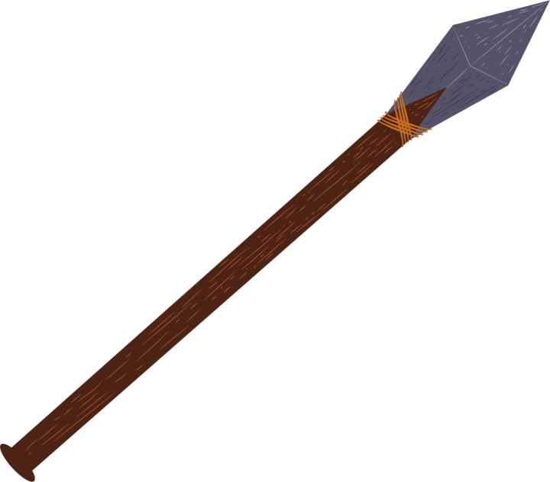
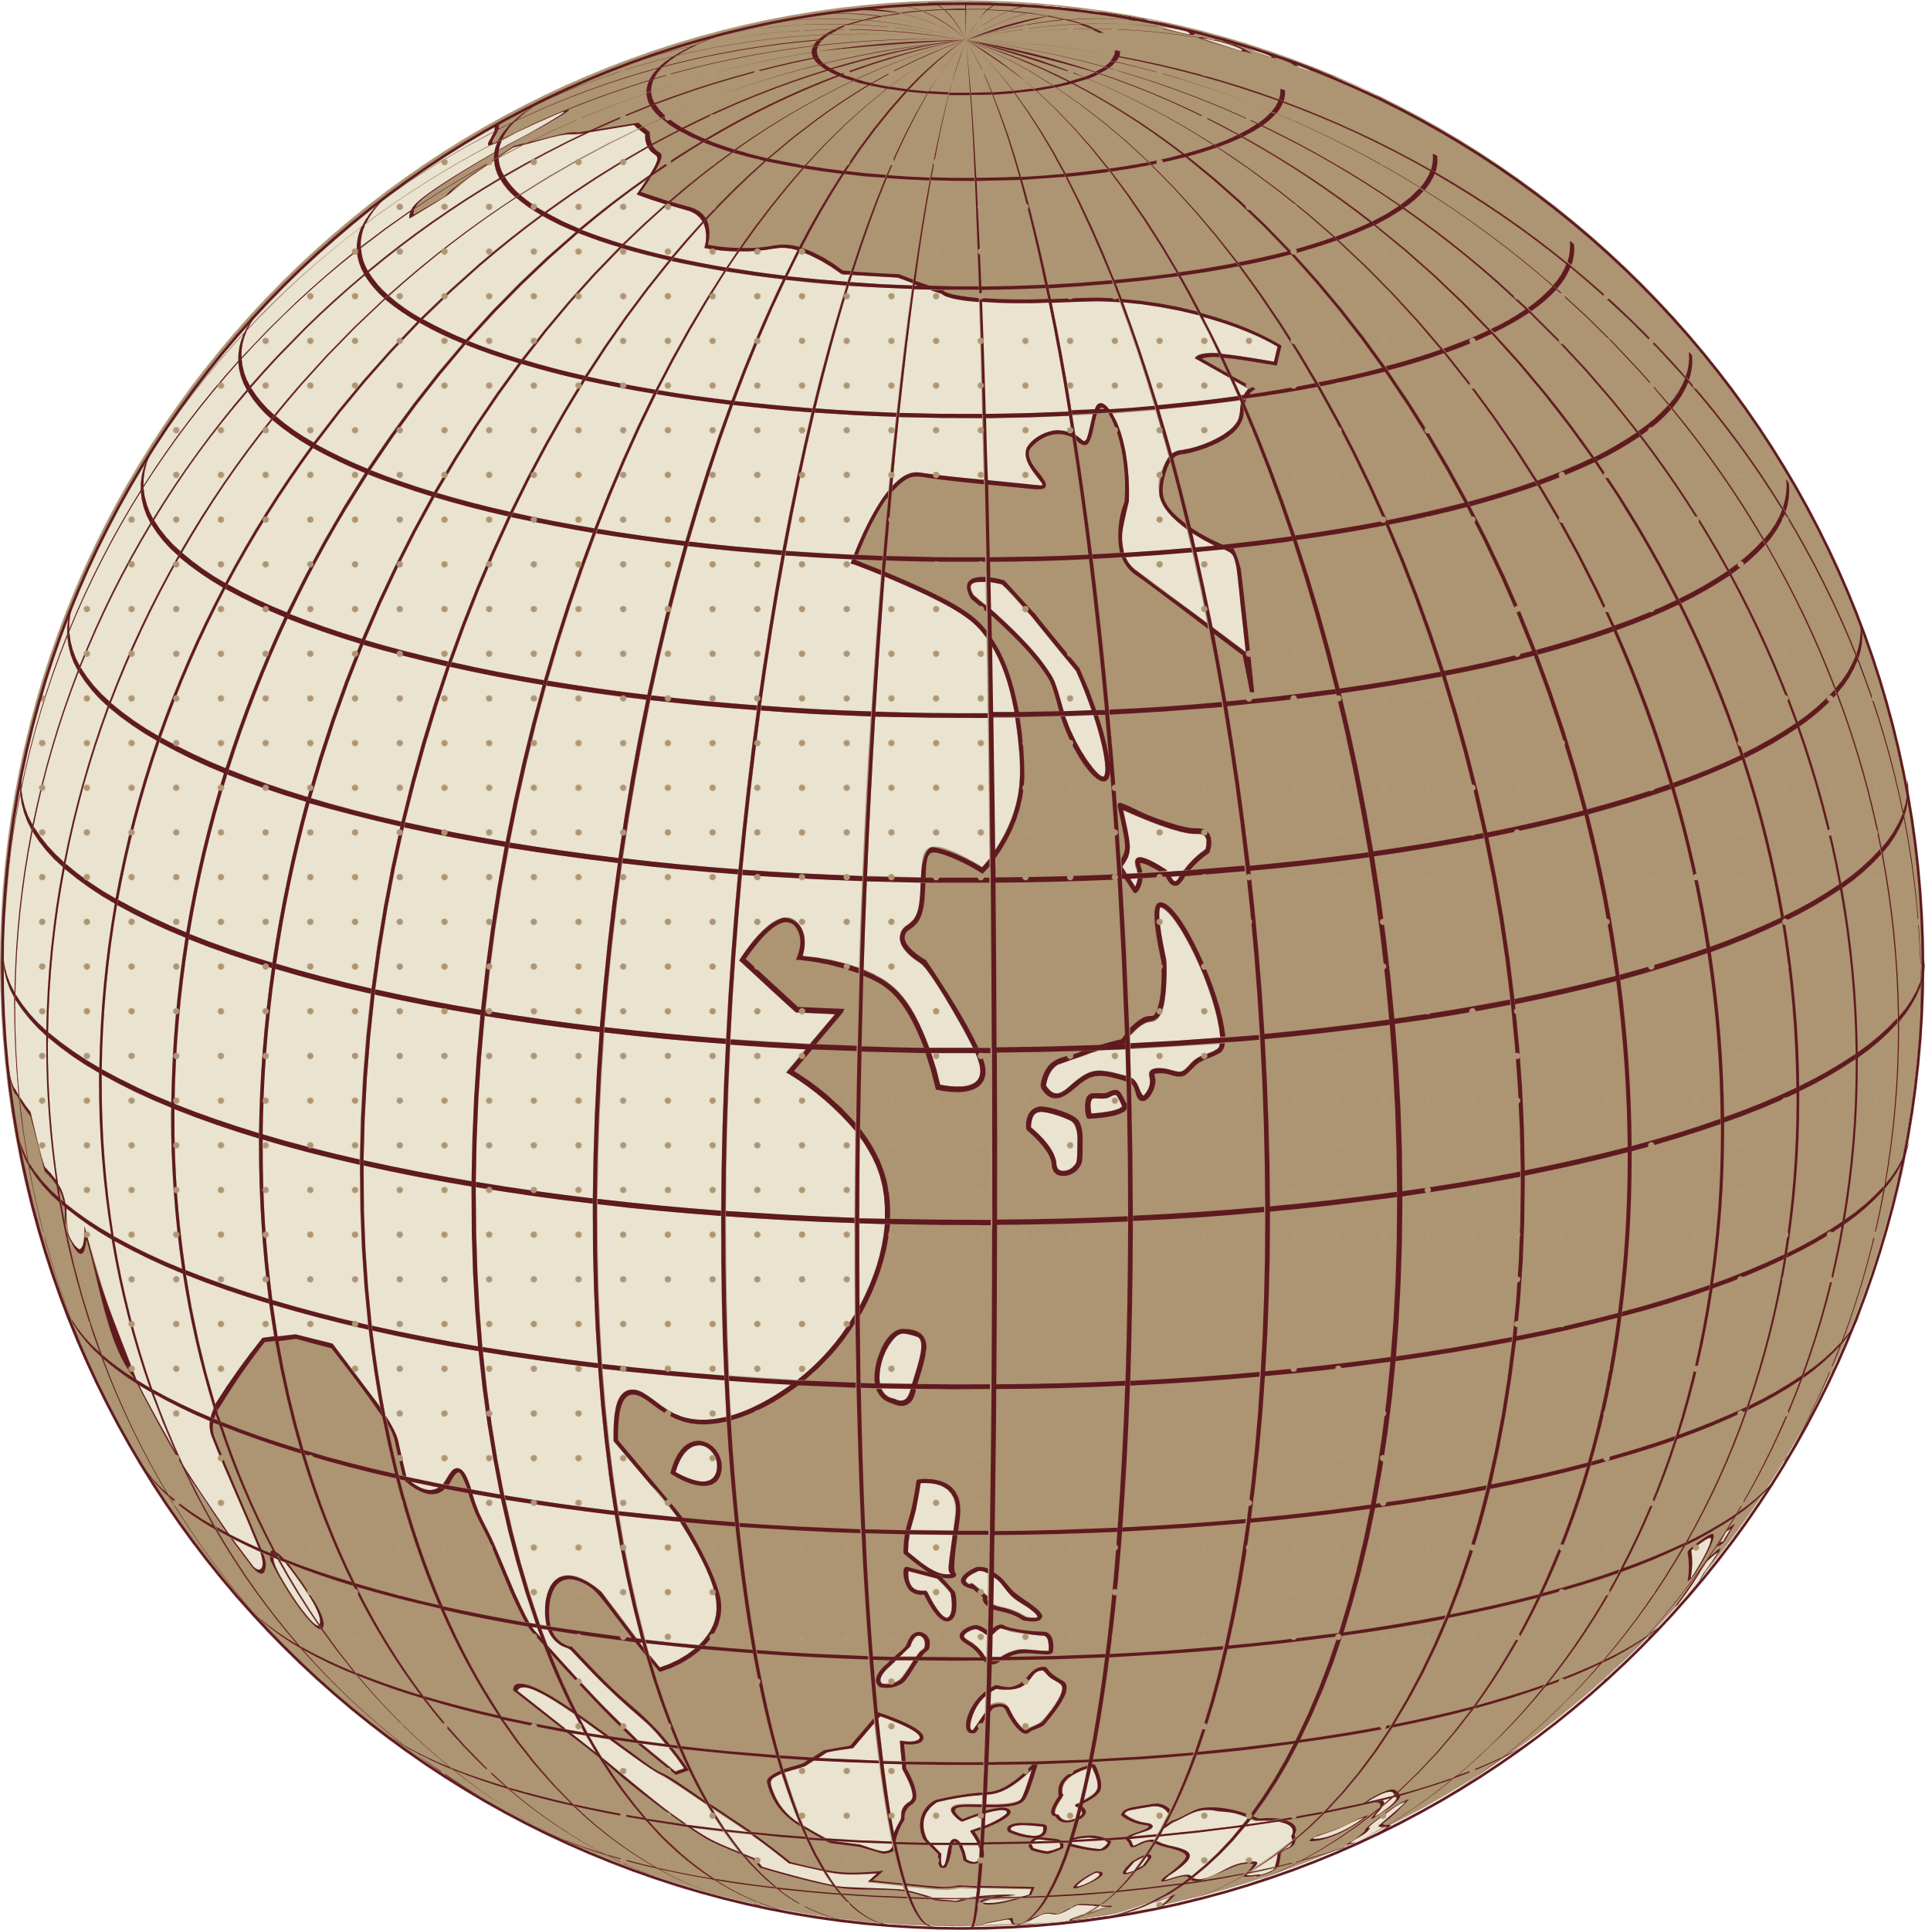
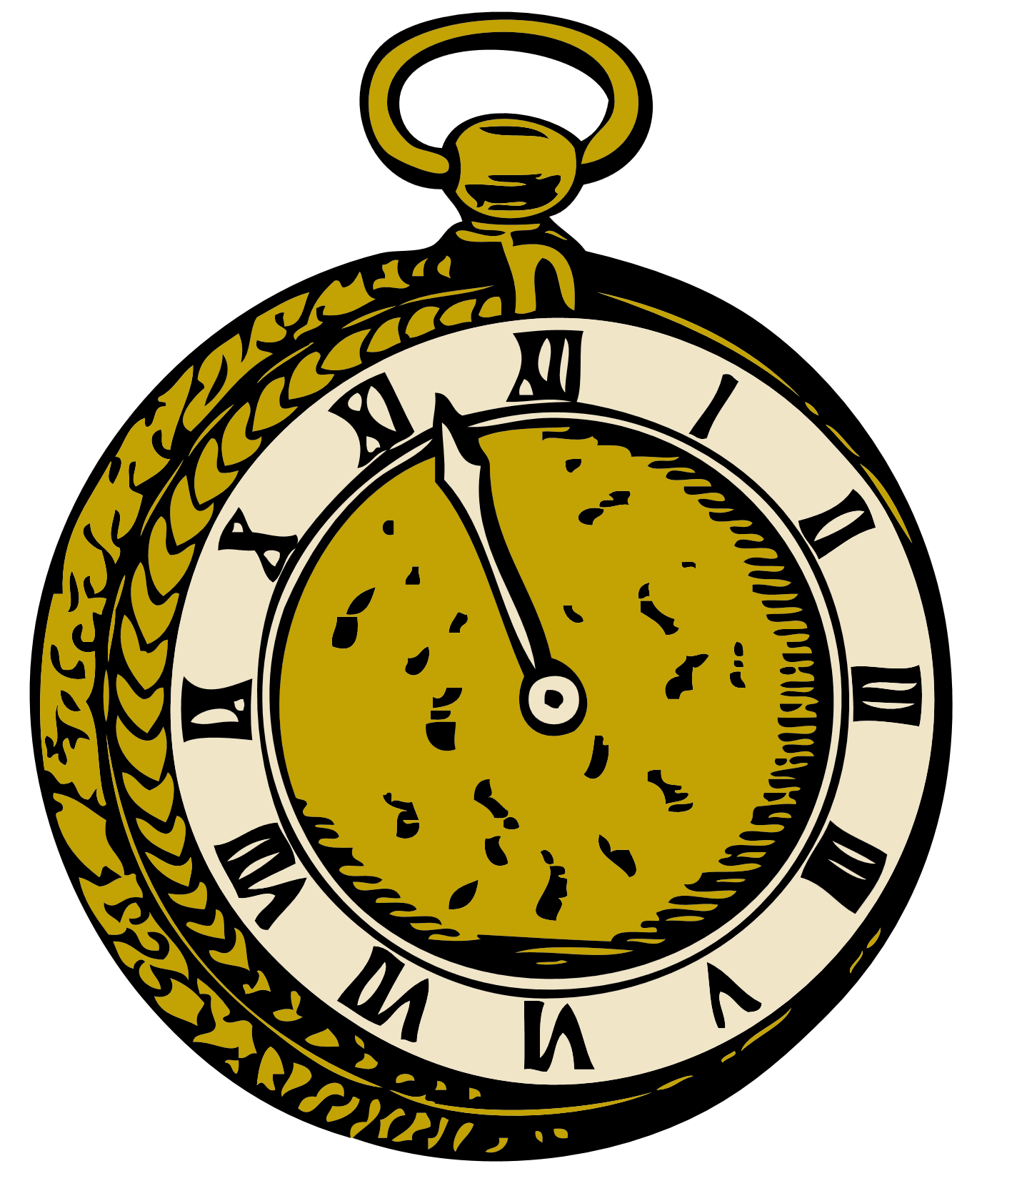
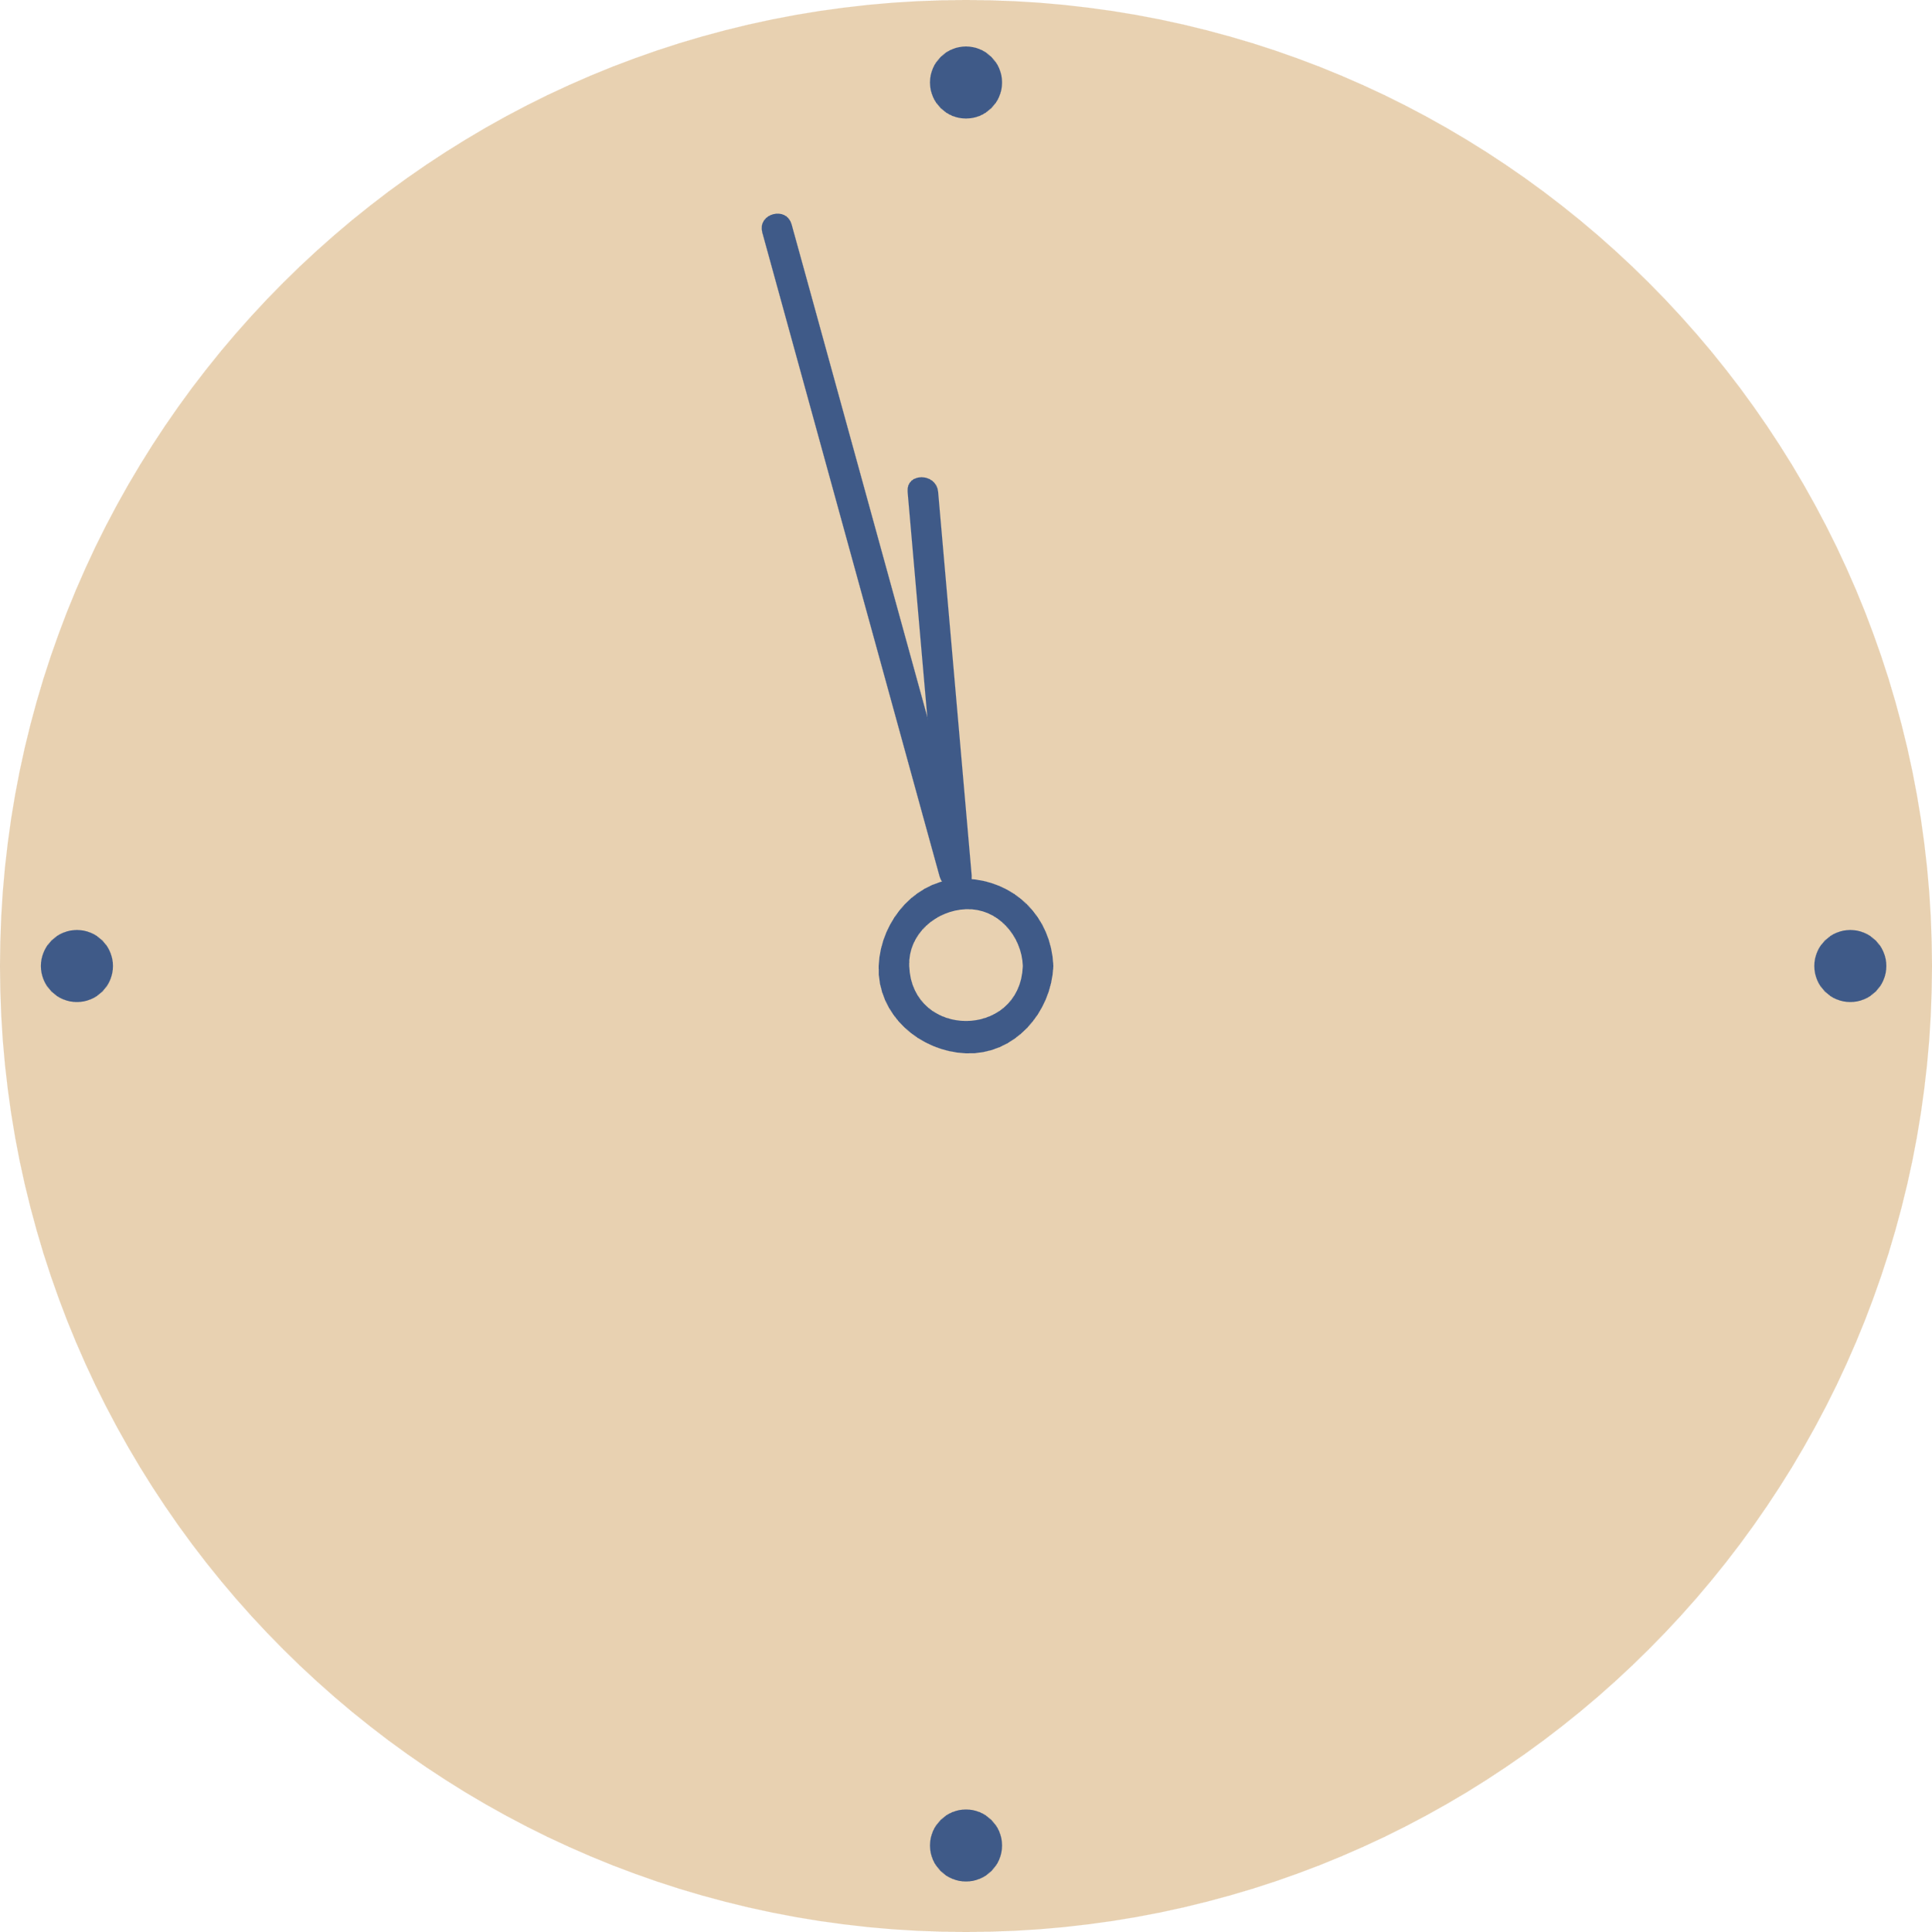
Tools for the
Historian
2- Timelines

Slide 2

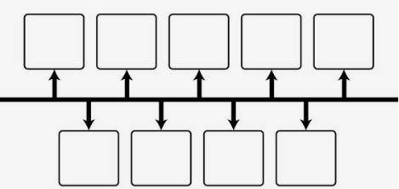
2- Timelines
  Timelines are tools to help you organize time and events.
  Another way to track the passage of time.
  A timeline is a diagram that shows chronological events or order of events within a period.
  Most timelines are divided into sections in which sections are evenly spaced.
  Events are placed on a timeline at the date when the event occured.

Slide 3
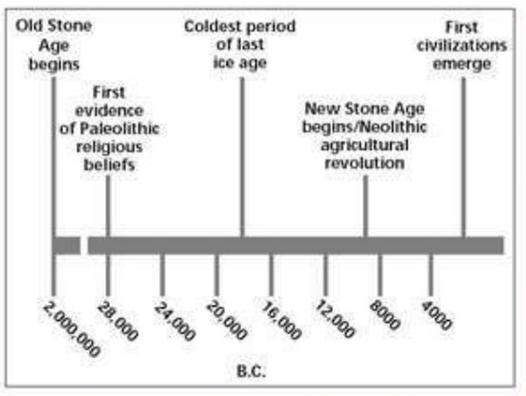
2- Timelines
  Sometimes the spread of time maybe too long to show all the years in even spaces.
  To save space, a period of time maybe leftout from the timeline.
  Where this happens, a slented line appears on the timeline to show a break in the even spacing of the events

Slide 4
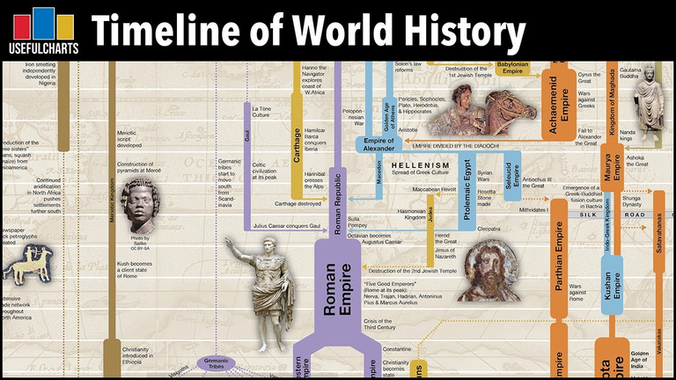
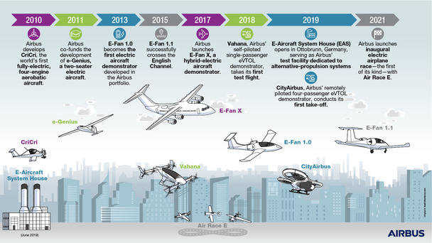
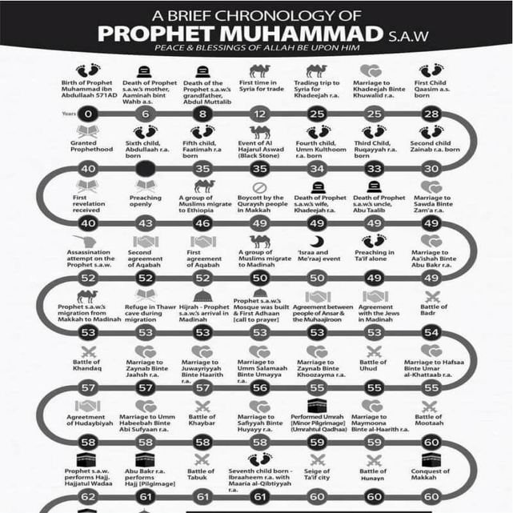
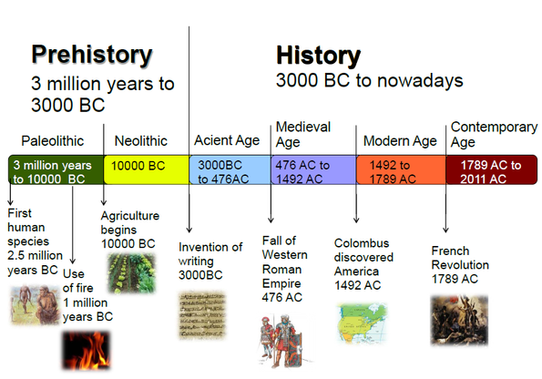
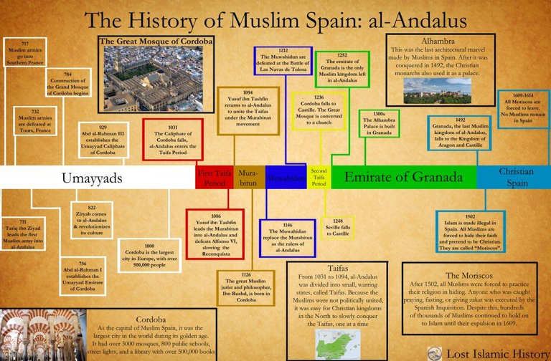
Timelines types

Slide 5
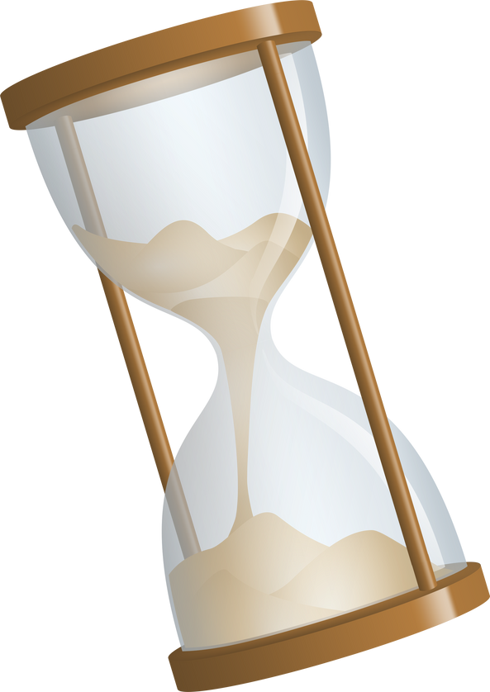
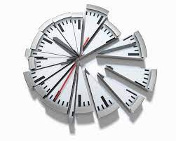

HOW IS TIME DIVIDED UP?

Slide 6

Put the following words in order. Start from the smallest
CENTURY
Minute
Decade
hour
Week
MILLENNIUM
Second
Day
YEAR
MONTH

Slide 7
How do we organize time?
One way to measure and organize time is to label groups of years, dividing it into blocks of time.
For Example, a group of 10 years is called a decade...etc

Slide 8
Can you match ?
  Decade
  Century
  Week
  Millennium
  Year
  100 years
  1000 years
  10 years
  365 days
  7 days

Slide 9
Solution
  100 years
  1000 years
  10 years
  365 days
  7 days
  Decade
  Century
  Week
  Millennium
  Year

Slide 10

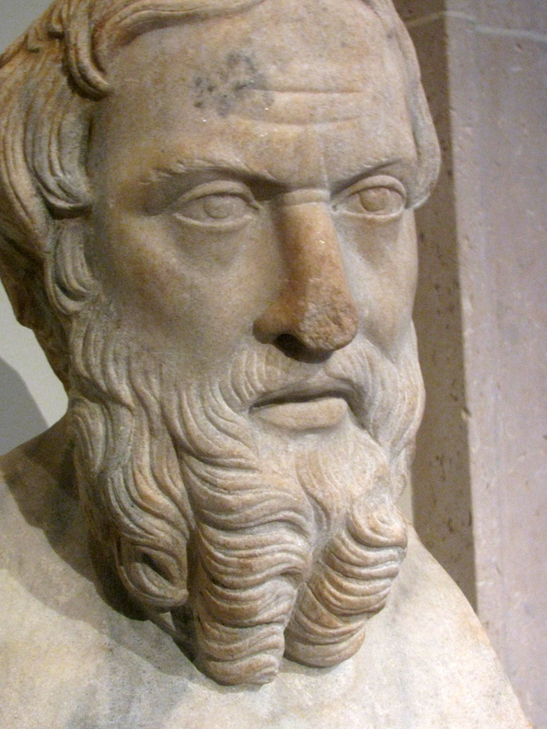
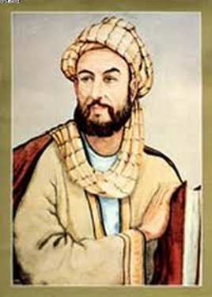
What is BC and AD?
What about BCE and CE?
Historians often talk about years as being BC or AD, or sometimes, they use BCE and CE . This is another way of dividing time.
This is a way of making large amounts of time easier to think about when learning history.

Slide 11



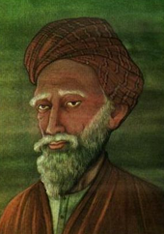
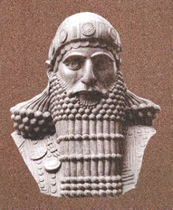
-BC
year 1
+ AD
Religious
when Jesus p.b.u.h. was born
Religious
-BCE
+ CE
Secular
2022 AD
now
Secular
2500 BC
500 AD
1500 AD
2500 AD
1500 BC
500 BC
1000 AD
2000 BC
1000 BC
2000 AD
AD moves forward in time from year 1 until you reach today
BC moves backward in time starting from year 1

Slide 12
Dividing up Time, Before or After
  Christians started counting the years from the year Jesus was born (year 1).
  AD= Anno Domini (Latin word=The year of our lord)
  BC =Before Christ, and it refers to any year before the birth of Jesus
  Later some people did not want to follow the religious names of the periods of time, they used instead:
  BCE =Before Common Era
  CE = Common Era

Slide 13
Activity 1: Complete this timeline with the following dates
1988 AD
-BC
+ AD
390 BC
1880 AD
year 1
1650 AD
500 BC
2022
Now
140 BC
54 BC
200 AD

Slide 14
Solution
Activity 1: Complete this timeline with the following dates
-BC
+ AD
140 BC
200 AD
1650 AD
390 BC
54 BC
1880 AD
1988 AD
year 1
500 BC
2022
Now

Slide 15
Activity 2:
Put the list of years in order starting with the most recent date.
Activity 3:
Put the list of years in order starting with the oldest date.
Most recent first set:2008AD-599AD-2010BC-2001AD-22BC-1-72AD-123BC
Oldest first set: 10,000BC-54BC-33AD-2008BC-2008AD-1-1008AD-410BC

Slide 16
Solution
Activity 2:
Put the list of years in order starting with the most recent date.
Activity 3:
Put the list of years in order starting with the oldest date.
Most recent first set:
1
22BC
123BC
2010BC
2008AD
2001AD
599AD
72AD
Oldest first set:
1
10,000BC
54BC
33AD
1008AD
2008AD
2008BC
410BC

Slide 17


HOW ARE CENTURIES NAMED?

Slide 18

We are in 2022, therefore this is the 21st century
This is because:
Years 1-99 AD was the 1st century.
Year 100-199 was the 2nd century.
This means that:
Year 175 AD is in the ........................century
Year 269 AD is in the ......................,century

Slide 19
Solution
We are in 2022, therefore this is the 21st century
This is because:
Years 1-99 AD was the 1st century.
Year 100-199 was the 2nd century.
This means that:
Year 175 AD is in the 2 nd century
Year 269 AD is in the 3rd century

Slide 20
Activity 4: Put this list of years into the correct century
  2008 AD
  950 AD
  33 AD
  1968 AD
  1789 AD
  1066 AD
  1848 AD
  54 BC
  410 AD
  1472 AD
  What Century ?
  What Century ?
  What Century ?
  What Century ?
  What Century ?
  What Century ?
  What Century?
  What Century ?
  What Century ?
  What Century ?

Slide 21
Solution
Activity 4: Put this list of years into the correct century
  2008 AD
  950 AD
  33 AD
  1968 AD
  1789 AD
  1066 AD
  1848 AD
  54 BC
  410 AD
  1472 AD
  21st Century
  10th Century
  1st Century
  20th Century
  18th Century
  11th Century
  19th Century
  1st Century
  5th Century
  15th Century

Slide 22





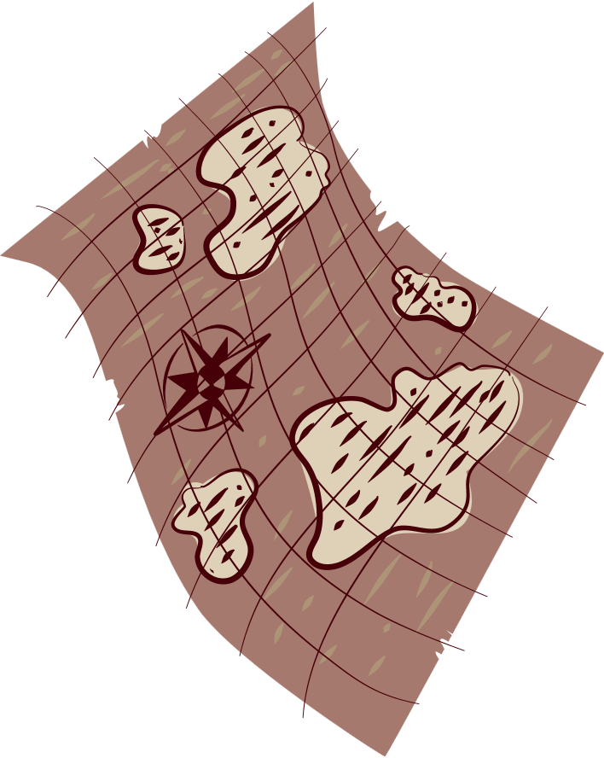

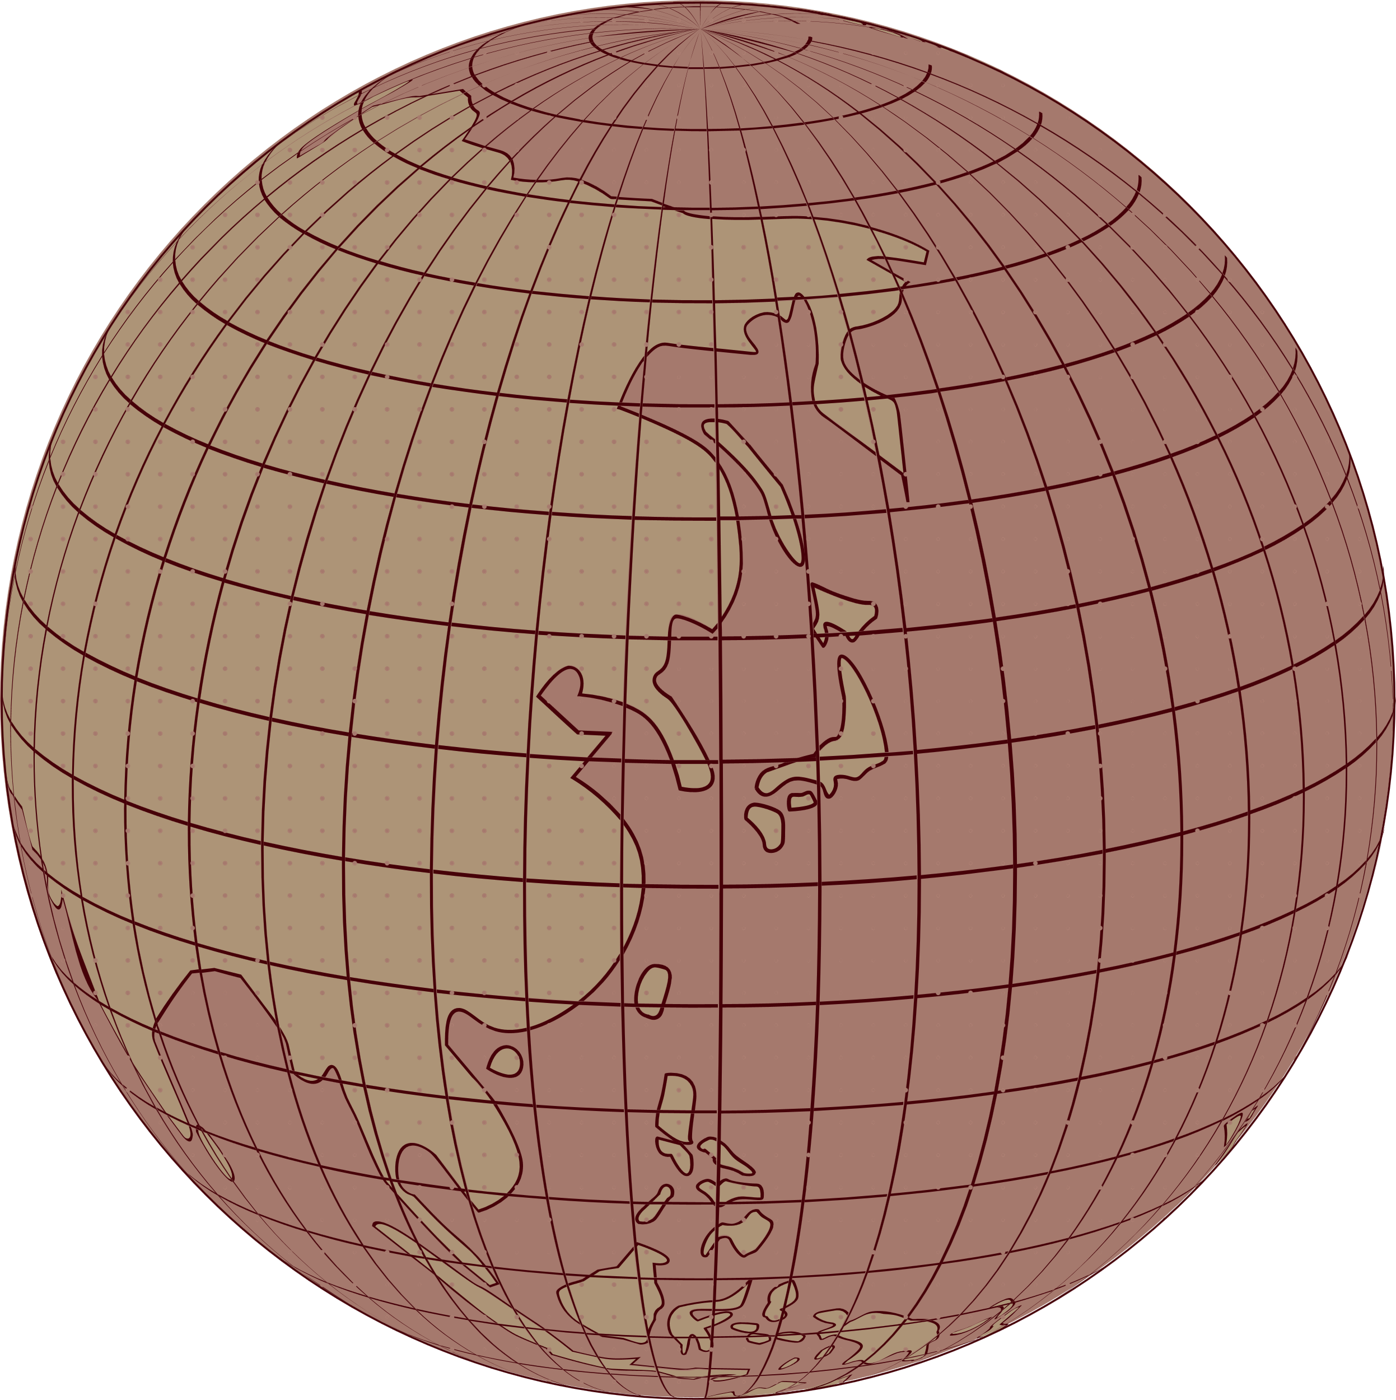


Historian
Tools of the
Measuring and Organizing Time

Slide 23
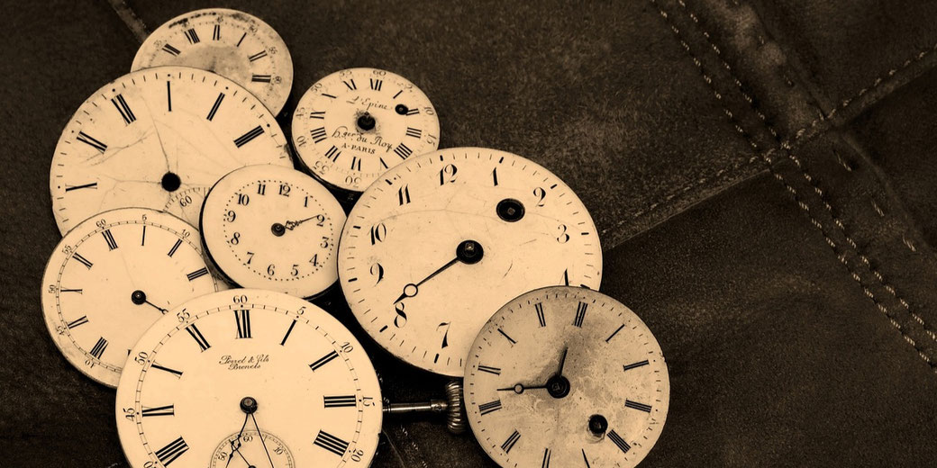

WHAT IS CHRONOLOGY?

Slide 24
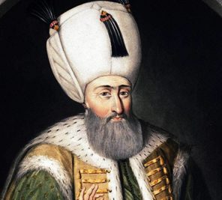
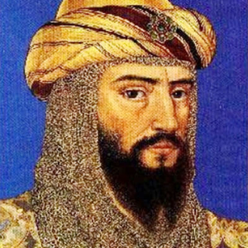
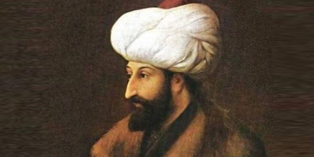
Chronology
Chronology is the study of when things happened
Events are put in the order of when they happened. This is called chronological order.
By putting things in chronological order we can discover interesting things about an event.

Slide 25
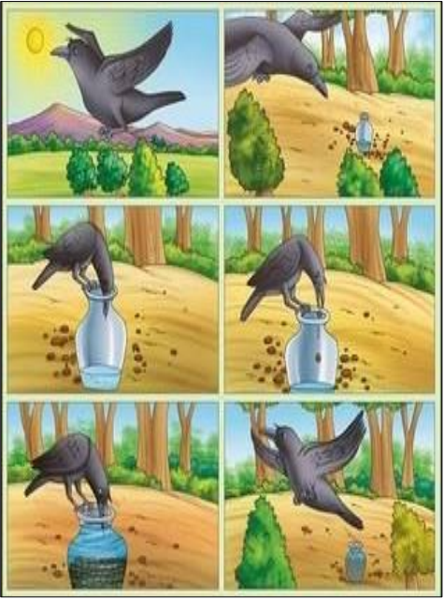
  To understand a story you must know what order things happened in.
  In history you can make up very different stories by changing the order in which things happen.

Slide 26
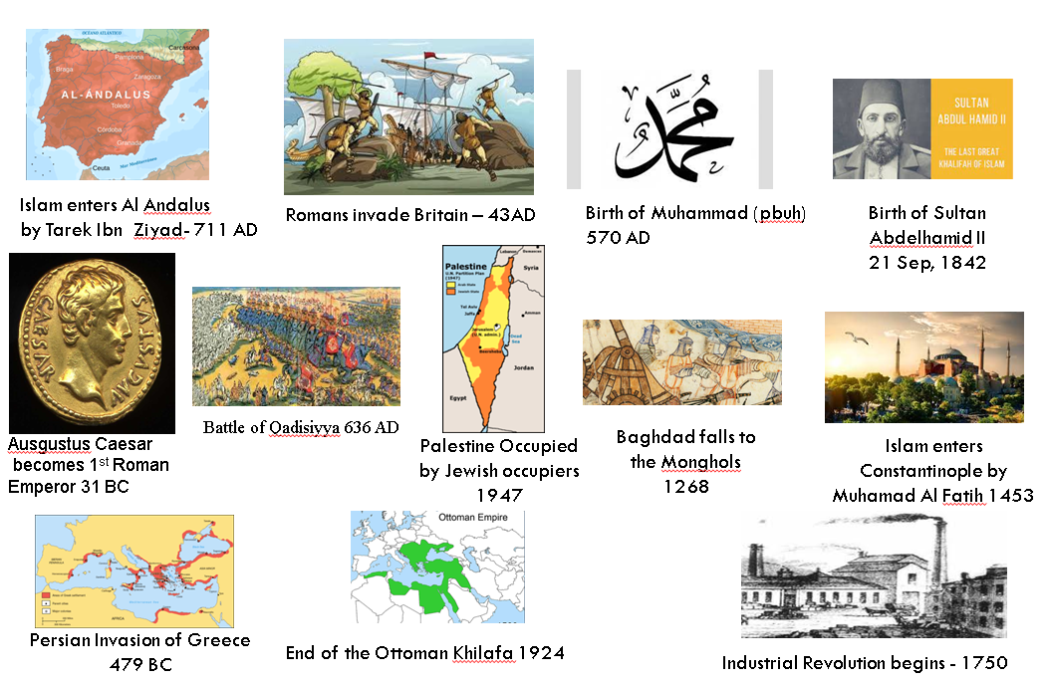

Homework 1
Put these events into chronological order.
Cut out the picture and write the information underneath as you glue them into Chronological Order.

Slide 27
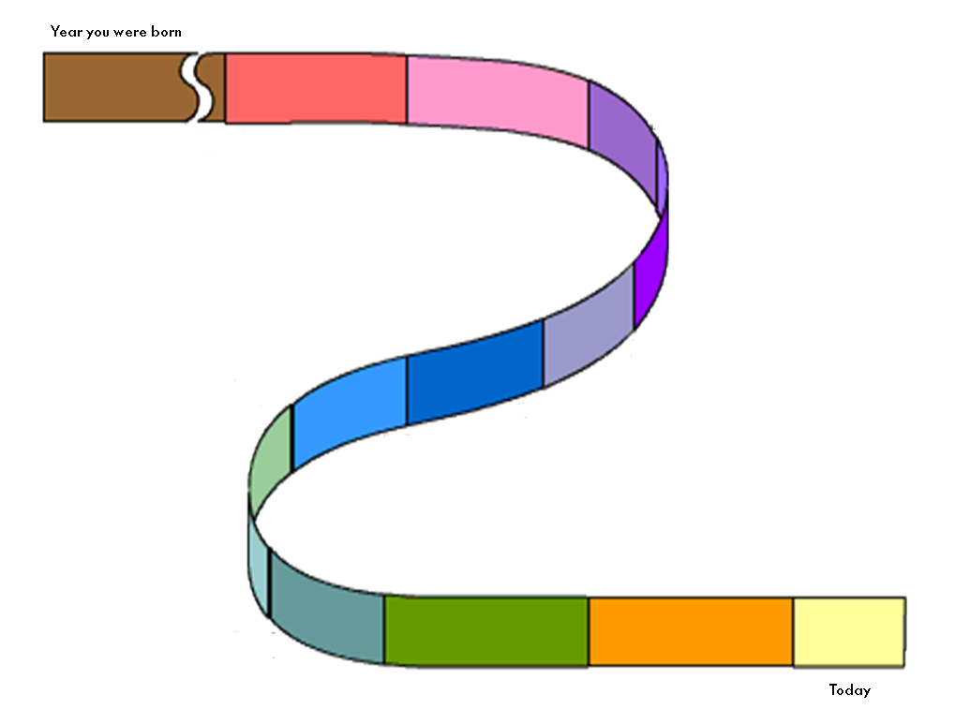
Homework 2
You are to complete the timeline of your childhood memories, giving a brief description about most years of your life

Slide 28
The End

