Slide 1
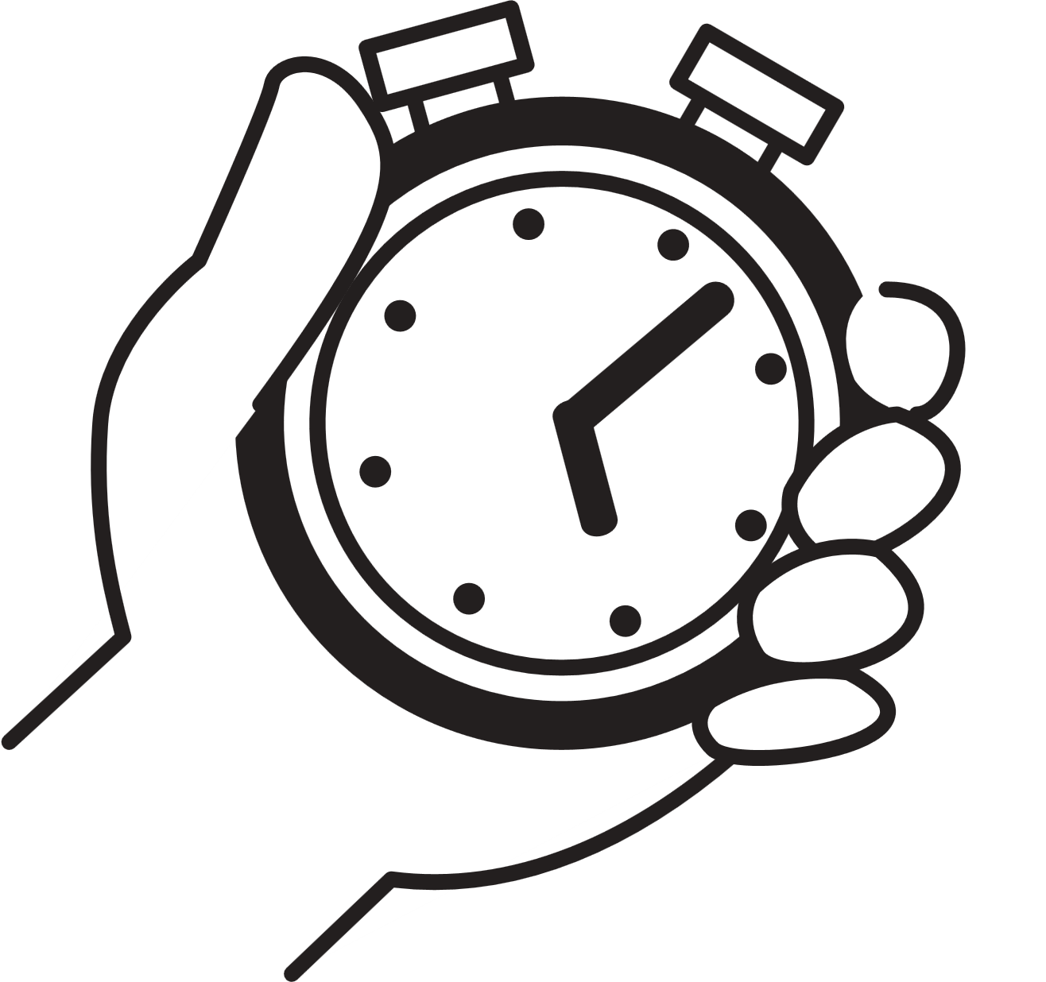

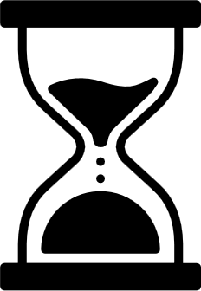
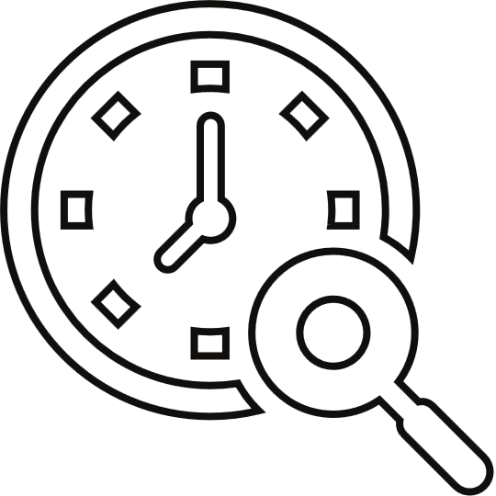
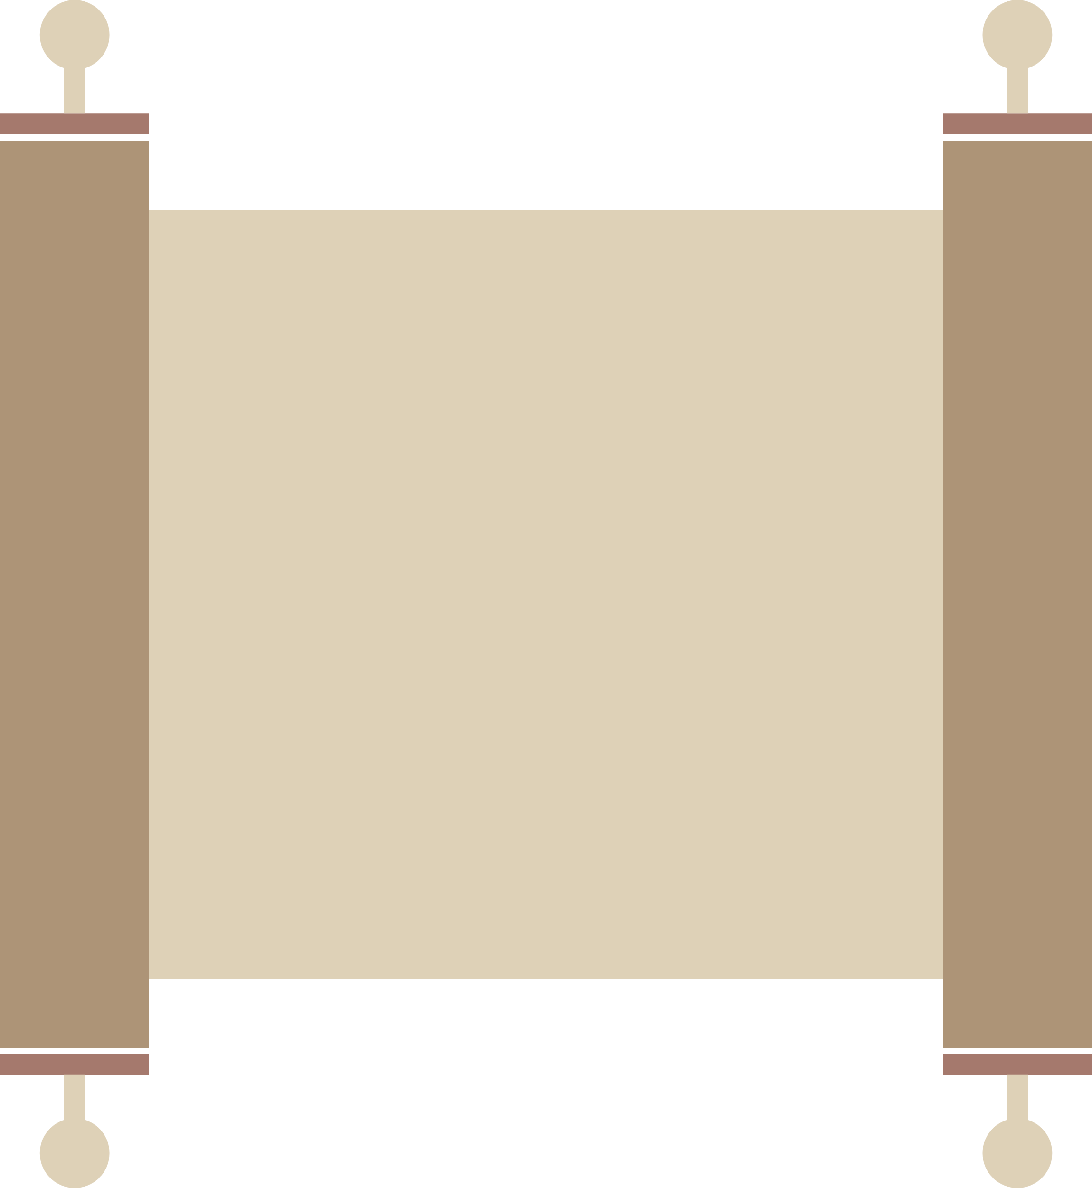

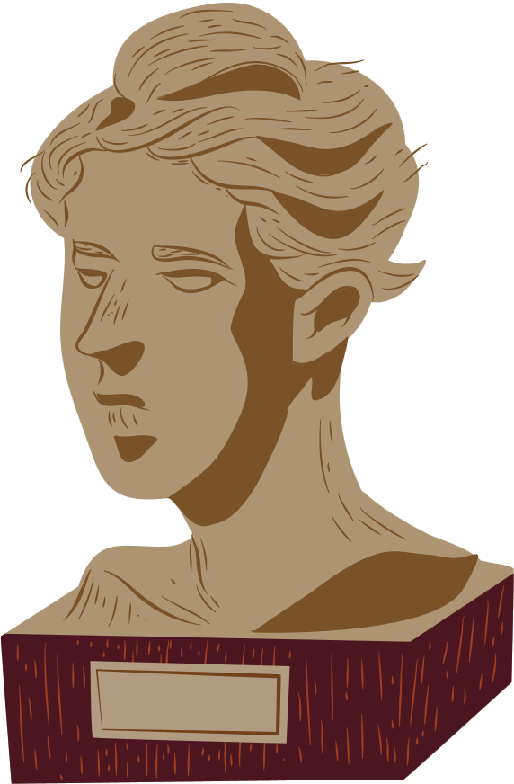
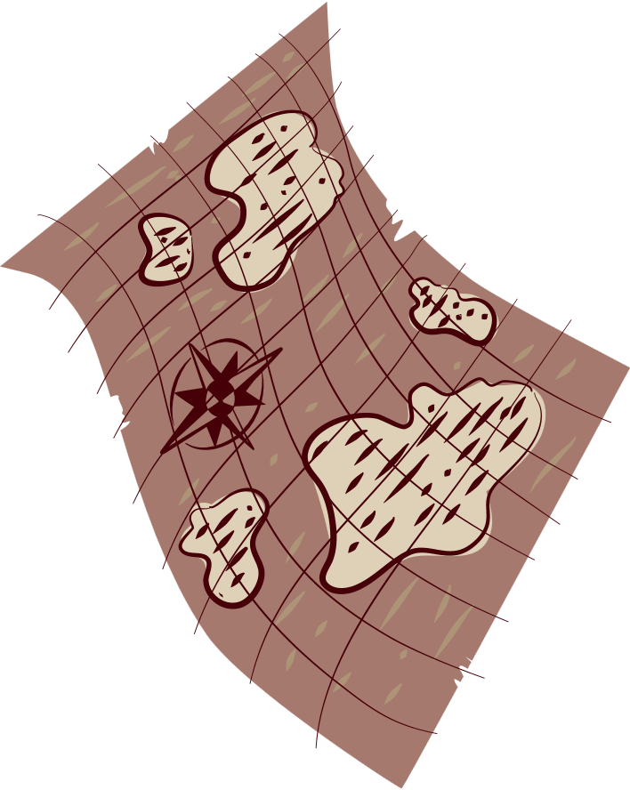
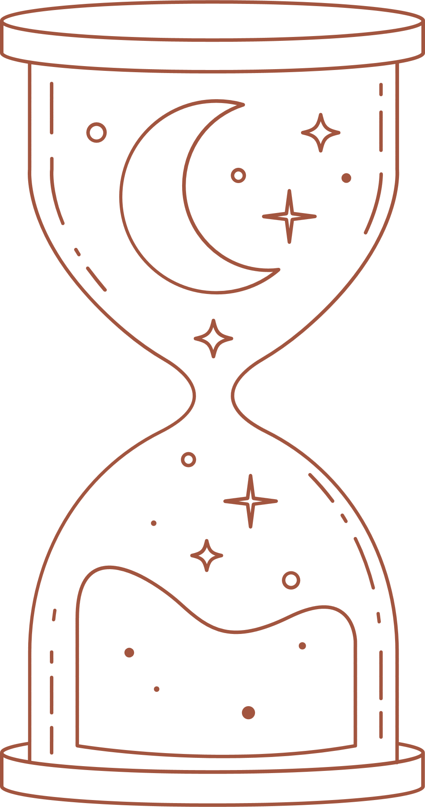
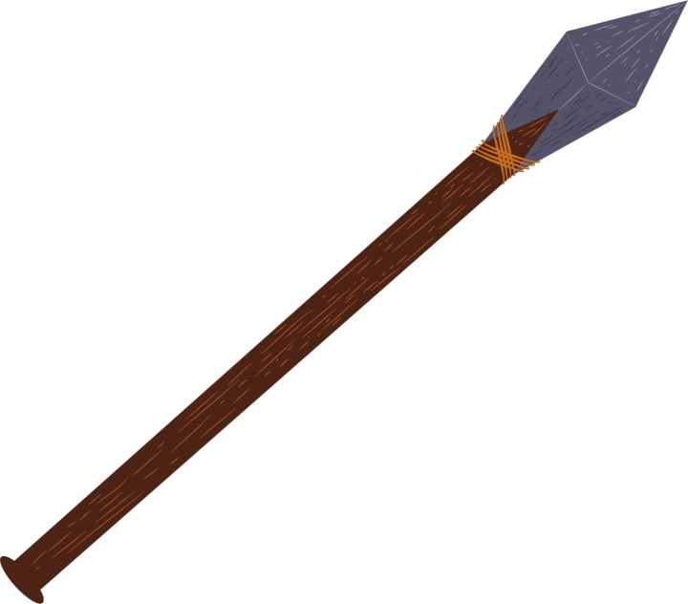
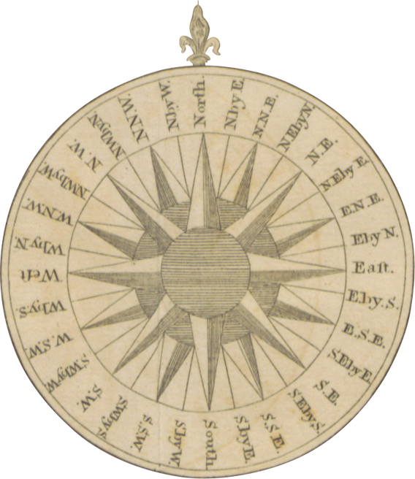
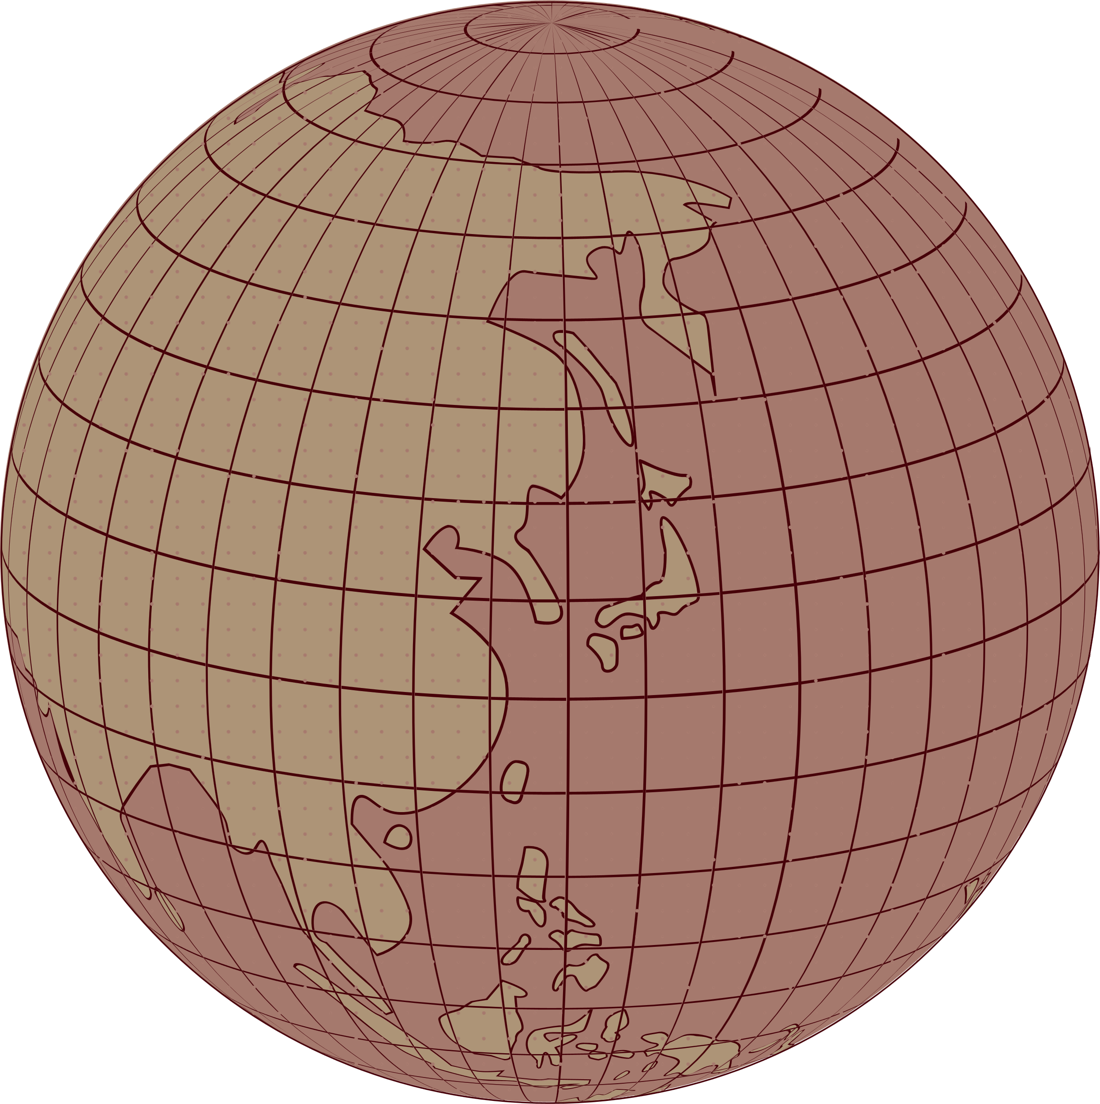


Historian
Tools of the
Measuring and Organizing Time
1-Calendars

Slide 2
Topics
  Tools of the Historian
  What calendars do we use today?
  How do we measure time?
  How do we organize time?
  Calendars
  Timelines
  calendars around the world

Slide 3
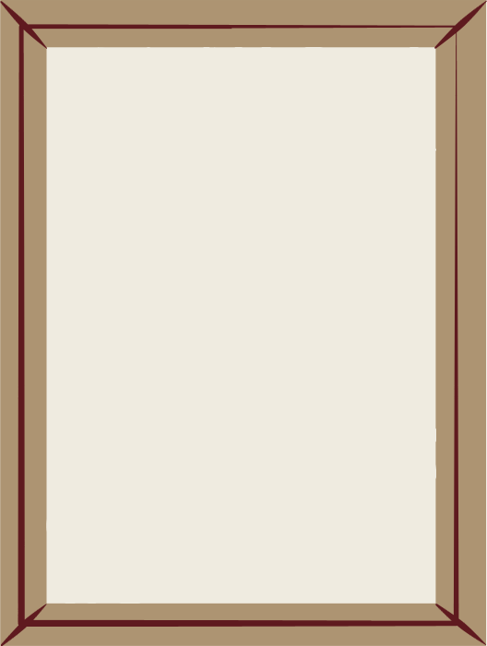
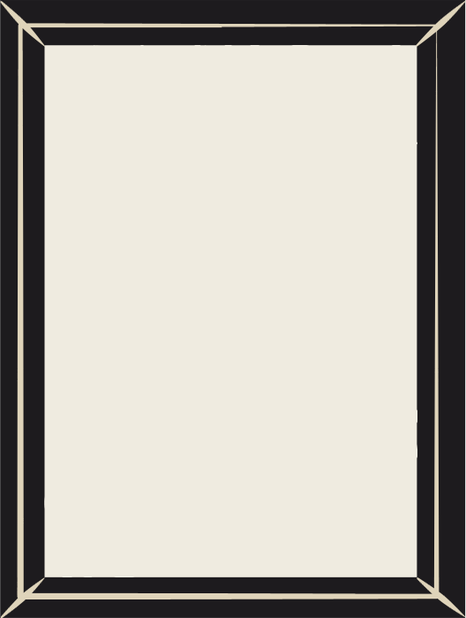
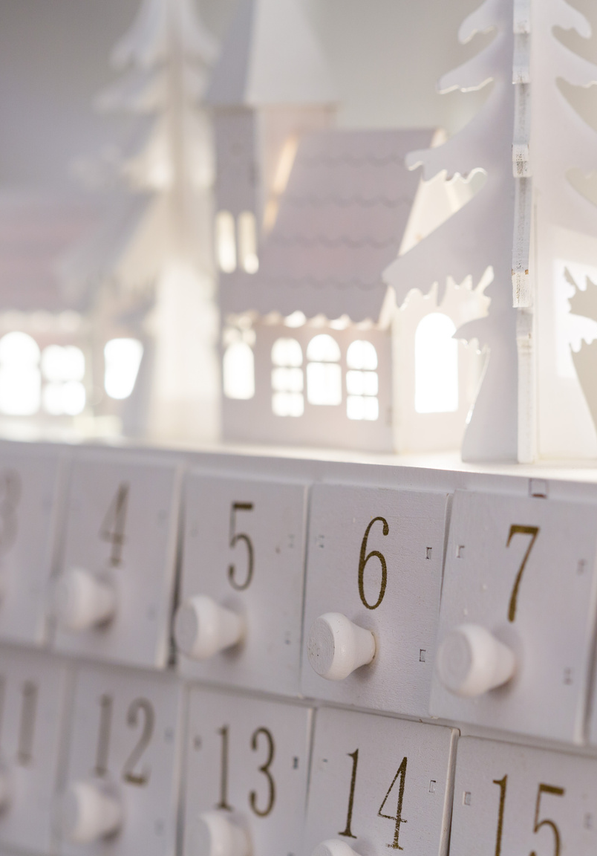
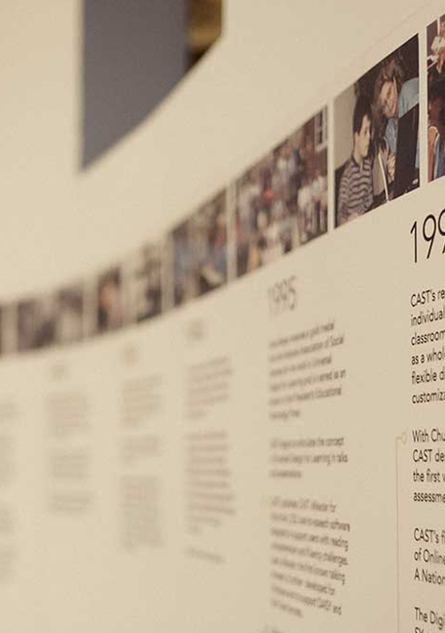
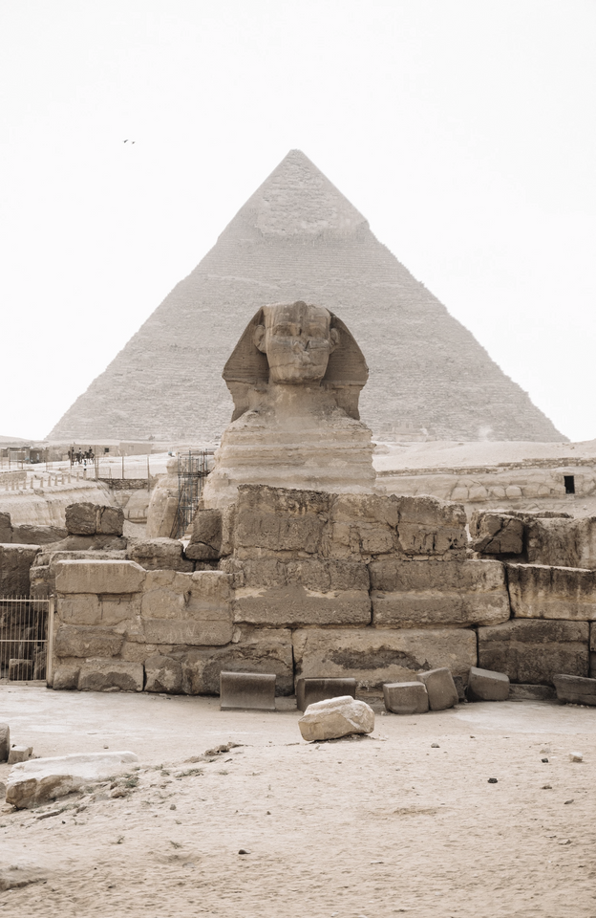
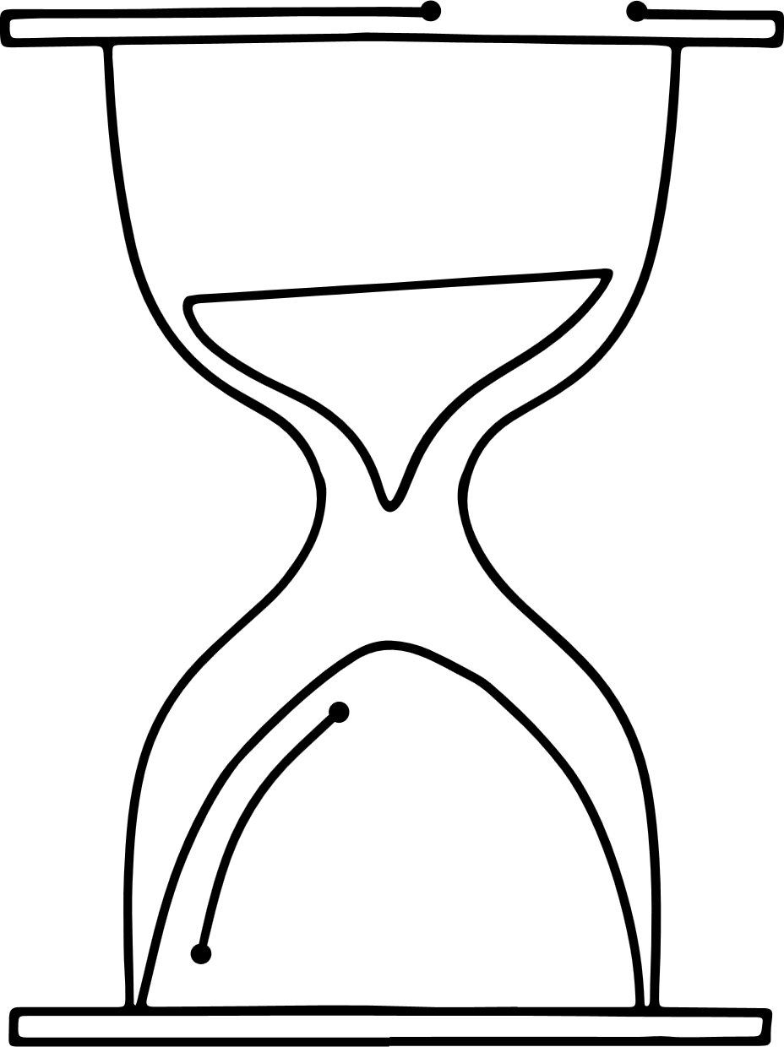
Tools of the Historian
Calendars
Timelines

Slide 4
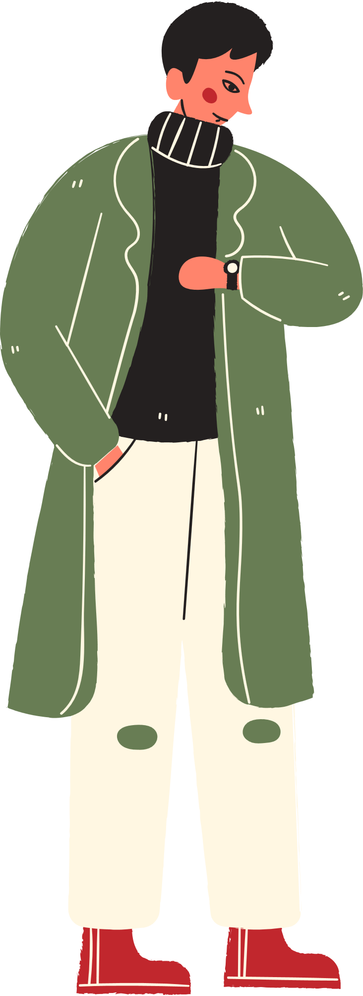
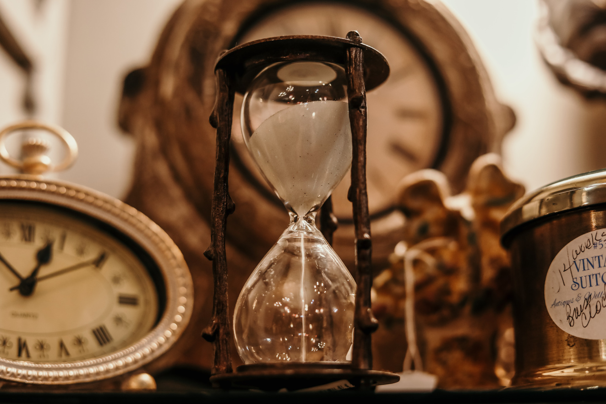
How Do We Measure Time?
  To study the past, historians must have a way to identify and describe when things happened
  They do that by measuring and labeling time in different ways.

Slide 5

1- Calendars
  We rely on calendars or dating systems to measure time
  A calendar arranges days in order

Slide 6
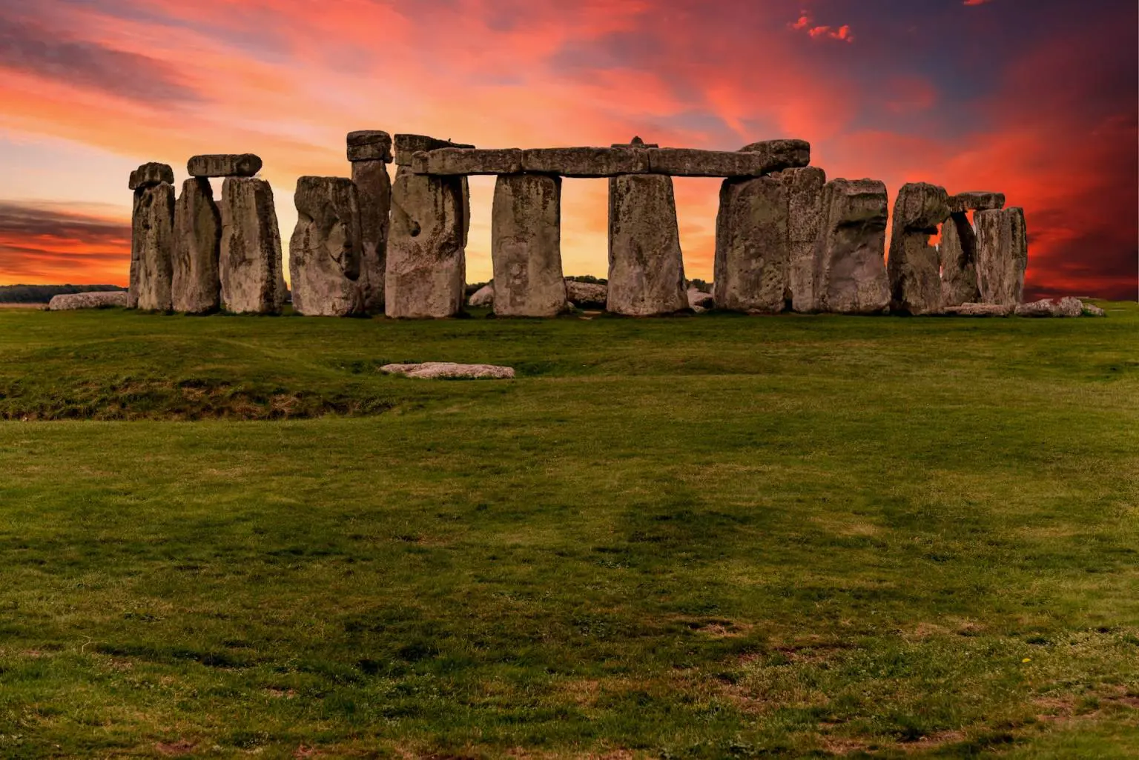
Why are calendars different from Culture to culture?

Slide 7
Calendars around the world
Civilization rely on calendars to organize and measure time. Culture, religion, and astronomy have all influenced calendars throughout history. The calendar evolution has been extreme dating back to ancient civilizations and developing into today’s sophisticated systems.

Slide 8
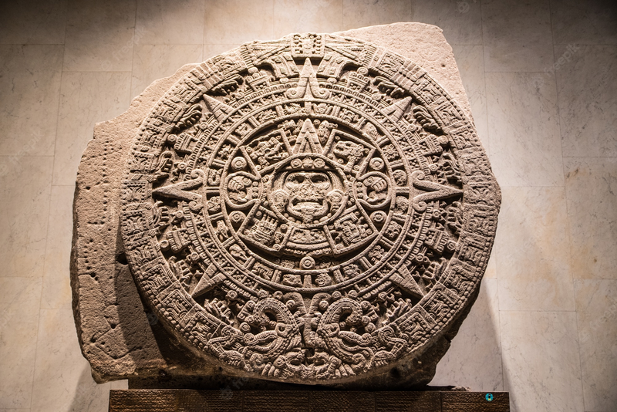
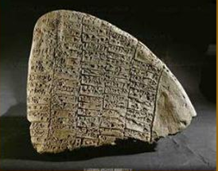
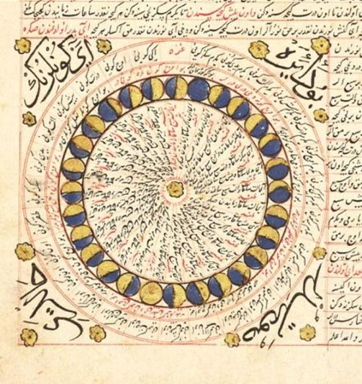
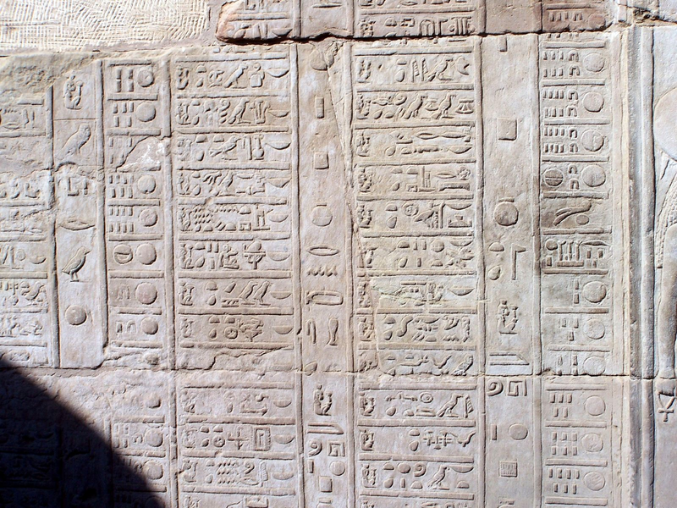
Calendars around the world
Aztec Calendar
Mesopotamian Calendar
Islamic Calendar
Ancient Egyptian Calendar

Slide 9
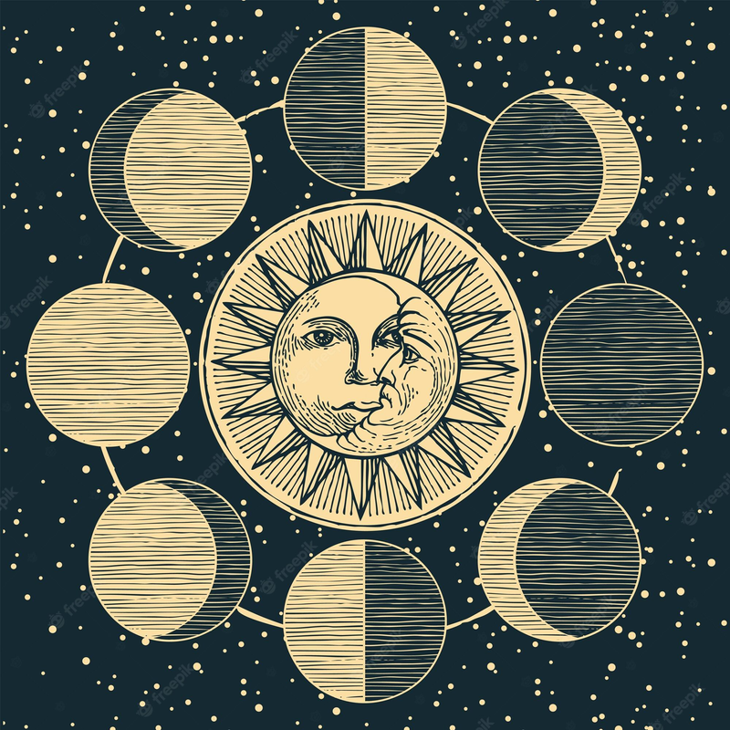
Calendars Based on Natural Phenomenon
  Different cultures around the world have developed 40 different calendars
  Some cultures have developed some calendars based on nature, such as the cycle of the moon.
  Example: The Chineese, The Jewish, and Ancient Egyptians

Slide 10
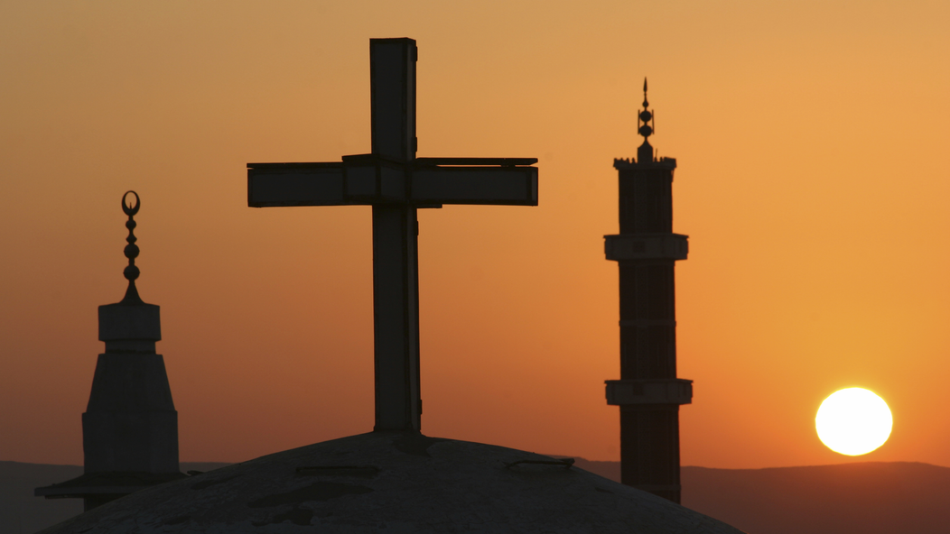
Calendars Based on Religious Events
  The Christian calendar starts with the birth of Jesus p.b.u.h.
  The Muslim Calendar starts with the Hijra of Muhammad p.b.u.h. from Makkah to Madinah.
  The Jewish calendar starts 3761 BC, the date of the creation of the world as described in the Old Testament.

Slide 11
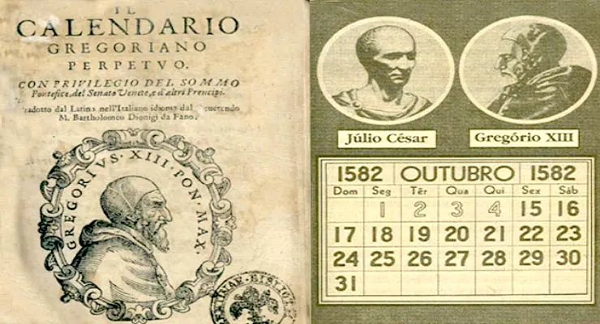
What calendar do we use today?
The calendar we use today is based in part on a calendar developed by Julius Caesar, a Roman Emperor. This calendar is called, "The Julian Calendar".
It has 365.25 days per year with a leap year every 4th year.
It was revised in 1582 by Pope Gregory XIII to start counting from the birth of Jesus Christ.
Most of the world uses this calendar today.

Slide 12
The End

