Slide 1
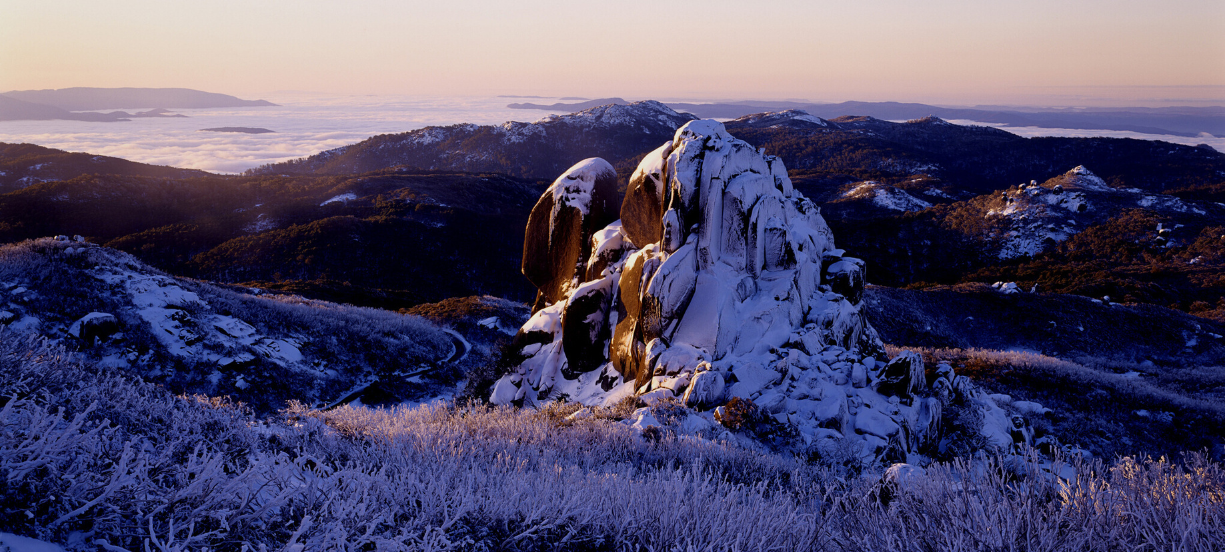
ÖTZI
THE ICE MAN

Slide 2
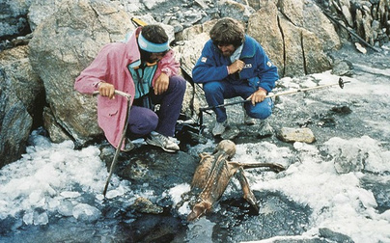
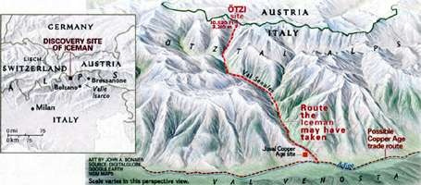
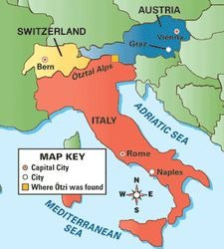
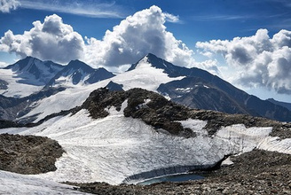
WHO IS ÖTZI THE ICE MAN?
Ötzi is a frozen mummy found by hickers in a glacier high in the mountains of the Ötztal Alps between Italy and Austria.

Slide 3
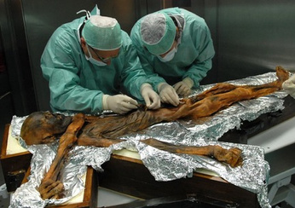
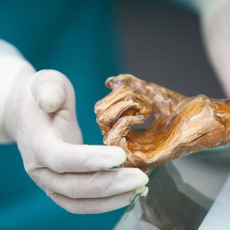
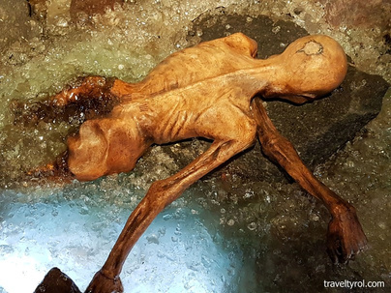
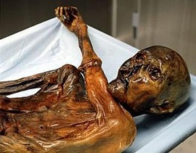

Take a look at the remains and examine them carefully, and see if you can spot any clues that tells you more about this person.

Slide 4
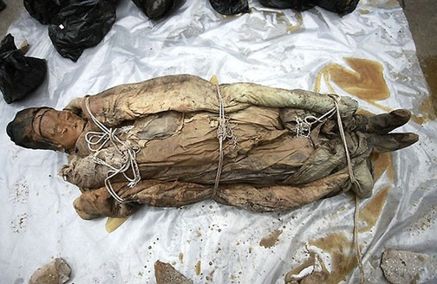
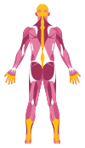

Ötzi is a wet mummy because it was mummified in a glacier ice. Mummies are different to skeletons because they still have body tissue, like muscles. Because he was frozen, Ötzi has been vey well preserved and scientists have learned a great deal about him by investigating his body

Slide 5
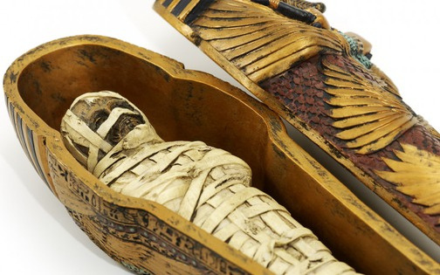

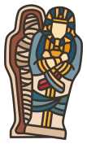
Unlike many mummies prepared for burial rituals, such as Egyptian mummies, Otzi has all his organs intact. This provides futher clues about him and his life.

Slide 6
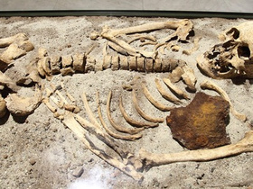
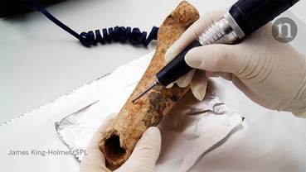
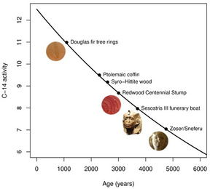
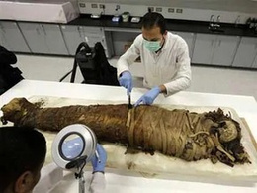

Ötzi lived over 5300 years ago making him the oldest intact human ever found.
We know he is this old because of Carbon dating. This is a process where scientists analyse the level of carbon in a body, fossil or dead plant. less carbon means the specimen is older, as living things are constantly replenishing carbon by eating and breathing.

Slide 7
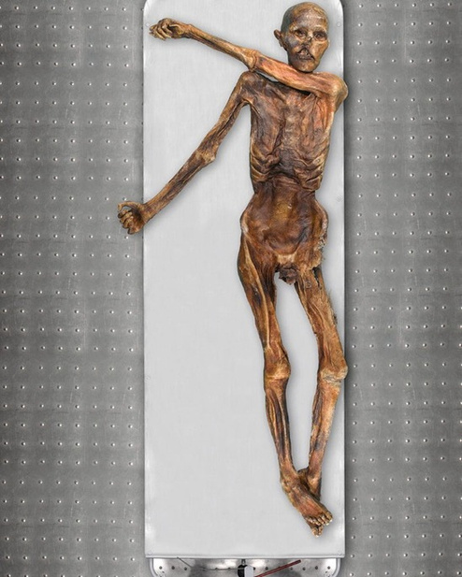
He was about 50 kilogrammes and stood 160 cm tall.
HOW TALL WAS ÖTZI?
Scientists looked at Ötzi's thigh bone and estimated his age of death to be around 45 because human bones alter with age, movement, and diet.

Slide 8
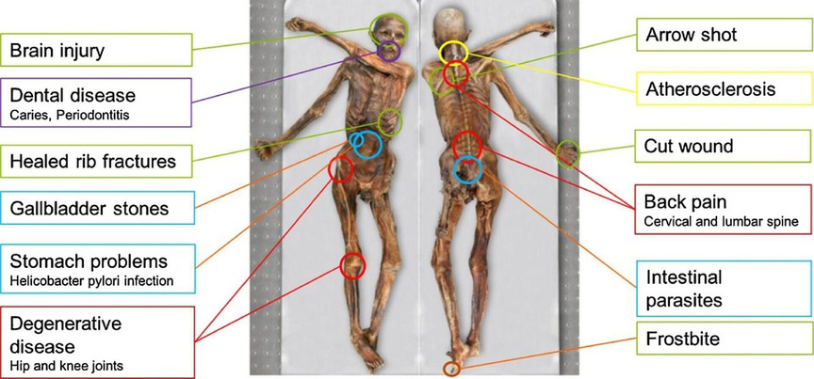
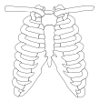
During his life, Ötzi's joints, bones, and teeth were subjected to significant wear and tear. X-rays revealed that he had broken his ribs and nose, lacked wisdom teeth, and had scarred fingernails.

Slide 9
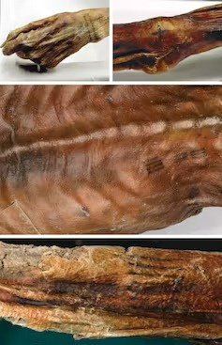
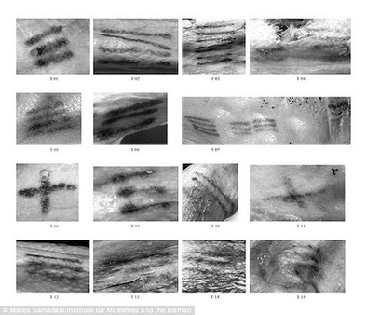
Ötzi s body is covered with 61 tattoos made from small cuts and crushed charcoal. They're near worn joints like his lower back, rib cage, wrist, ankles, and knees.

Slide 10
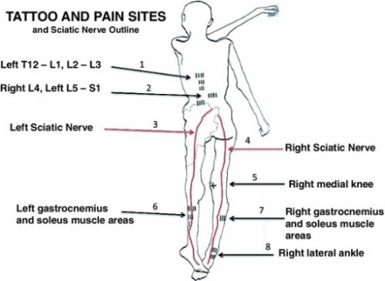
WHAT DID ÖTZI'S TATTOS MEAN?
His tattoos are in similar locations to where accupuncture is used now and many of these body areas would have garments on them. Therefore, scientists believe that rather than trying to adorn his body, he was trying to relieve suffering.

Slide 11
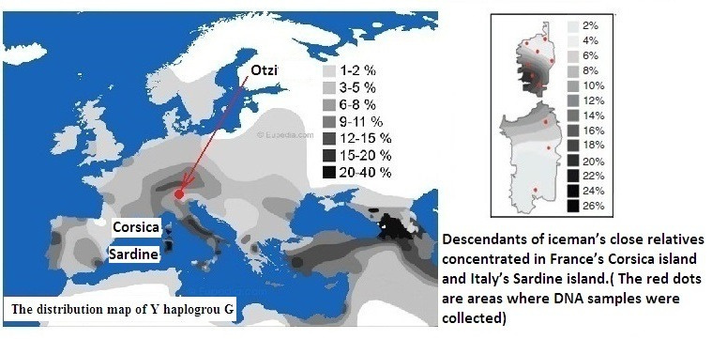
WHAT IS ÖTZI THE ICEMAN ANCESTRY?
Scientists were able to analyse Ötzi's DNA, it revealed that his family had lived on the islands of Sardinia and Corsica. We know this because these populations had been isolated for a long time and had particularly rare genes.

Slide 12
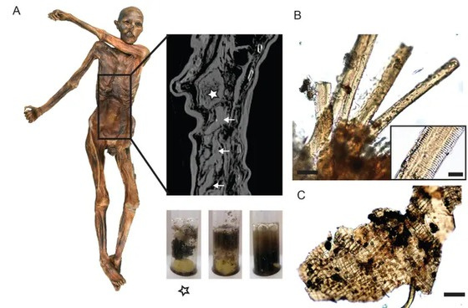
Soot was discovered in Ötzi's lungs, most likely from inhaling smoke from open fires, according to scientists who examined his organs.
WHAT IS ÖTZI'S DIET?
An analysis of Ötzi's Stomach revealed his last diet, traces of red deer and ibex meat, ancient wheat and plenty of ibex fat.

Slide 13
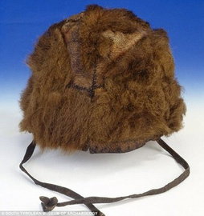
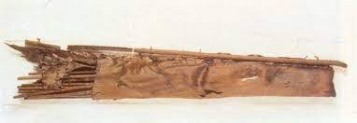
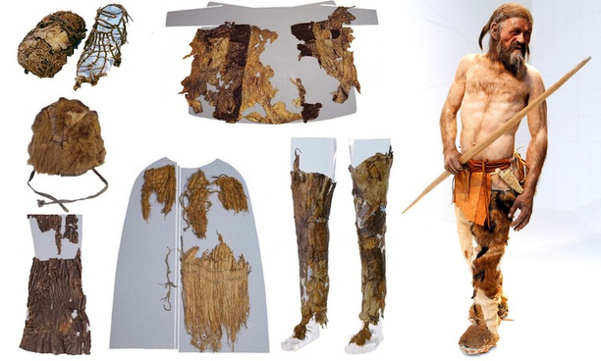
Scientists reveal Ötzi sported sheep and goatskin coat and a luxurious bear-fur hat.
WHAT WAS THE ICEMAN WAS WEARING 5,300 YEARS AGO?
His quiver was made from a roe deer and his leggings from goat hide.
They were made in several layers and stitched together with grasses and tree bark to keep the cold out.

Slide 14
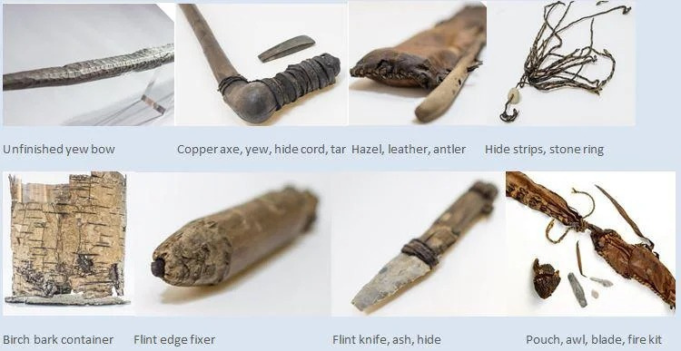
In a wooden backpack, Ötzi carried an axe, bow and arrows, dagger, and blade sharpener. Apart from the axe, all of his belongings were made of natural materials such as branches, bark, flint, leather, and antlers. His axe was made of copper, a new and extremely rare material at the time. This suggests that Ötzi had a high social status in his community.
WHAT ABOUT HIS WEAPONS?

Slide 15
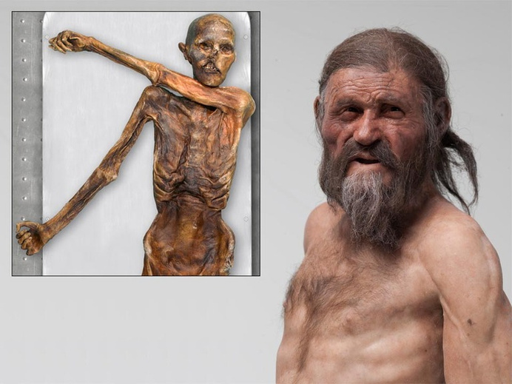
WHAT DID ÖTZI LOOK LIKE?
Scientists learned so much about his life and history that they were able to build a model of how he would have appeared. They said, he had dark, medium-long hair, probably had a beard, had brown eyes

Slide 16
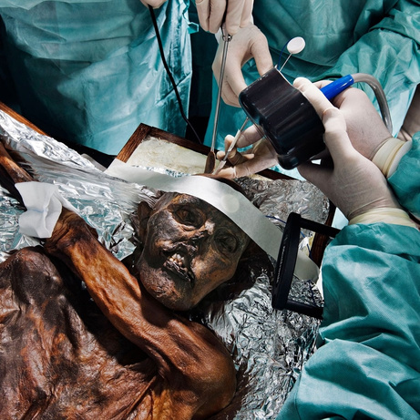
NOW THAT YOU KNOW ALL OF THIS ABOUT ÖTZI, CAN YOU THINK ABOUT HOW HE DIED?
Print out the worksheet to learn further about him.

