Slide 1
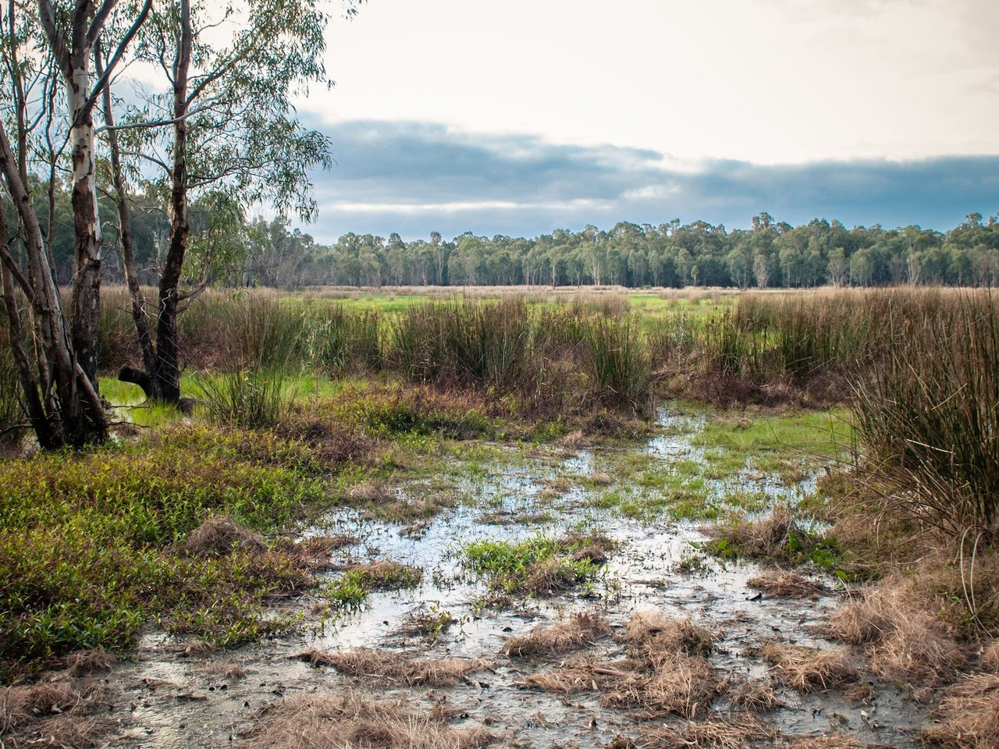
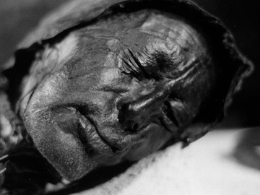
HISTORY INVESTIGATION
THE MYSTERY OF THE TOLLUND MAN
The Bog Body

Slide 2
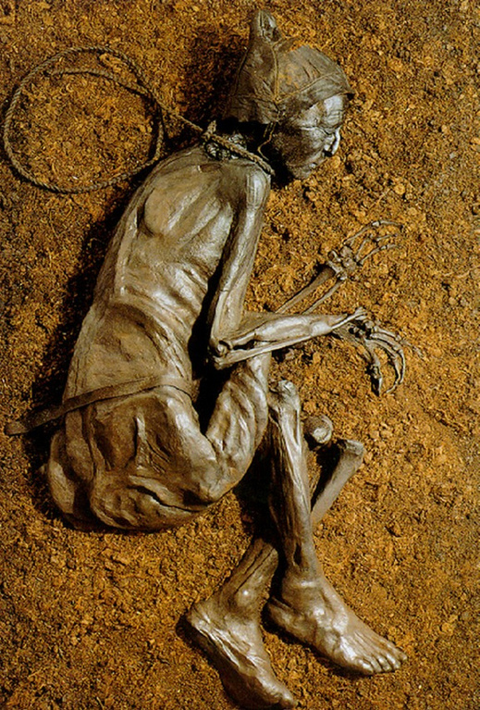
Who is the Tollund man? Historical sources Primary and secondary sources Types of sources History Detectives History Investigation So what happened to the Tollund Man? Think like a Muslim Historian

Slide 3
WHO IS TOLLUND MAN
Discuss the following questions using the image in front of you:
What 3 things can you see ? What do you believe happened to this individual? Do you have any questions you'd like to ask to learn more?

Slide 4
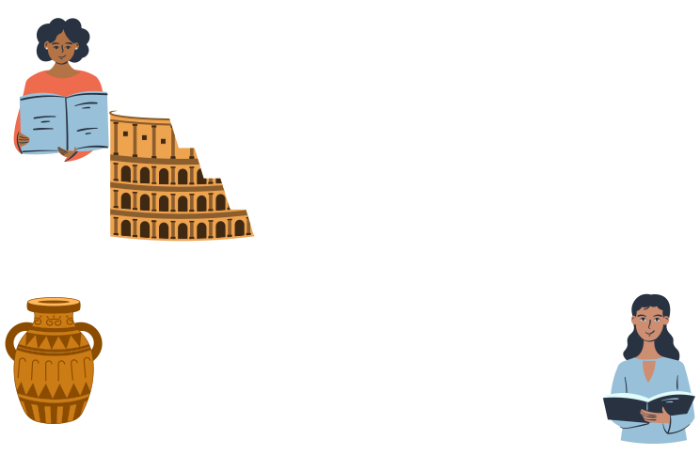
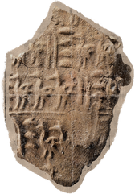


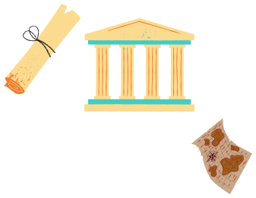


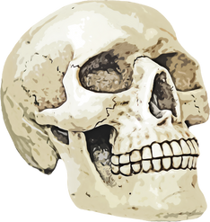
Historical Sources

Slide 5

Sources are…
the hints or clues that provide information about the past, such as details about how people lived or what they did or thought.
Sources are...
anything from the past. All sorts of things can be sources: documents (written sources), pictures, buildings, artefacts (objects) and even skeletons.

Slide 6
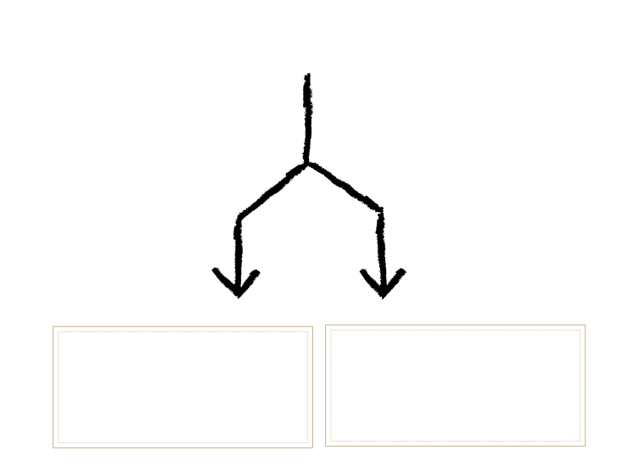
PRIMARY AND SECONDARY SOURCES
Primary SourceSecondary Source
A record made by people who saw or took part in an event (at that time)
A record of an event written by someone (after that time)

Slide 7


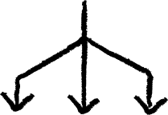




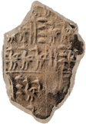

DIFFERENT TYPES OF SOURCES
Oral
Picture/ Written
Object/
Artefact

Slide 8

Task:
How many different kind of sources can you think of? List at least 5 other different types of sources onto the spider diagram.
Newspapers .................. ...................
Skeletons .................. ..................
Tools .................. ...................
Sources
Clothing
Objects
................... ...................
................... ...................

Slide 9

HISTORY DETECTIVES
A History Detective is somebody who looks at evidence from the past.They do not want to catch criminals or bring anybody to justice with this evidence. History Detectives want to learn about the past from the clues other people leave behind. The further back in the past we look the harder it is to find clues. A "Source!" is anything that a historian uses as evidence.

Slide 10


HISTORY INVESTIGATION
SO WHAT HAPPENED TO THE TOLLUND MAN?

Slide 11
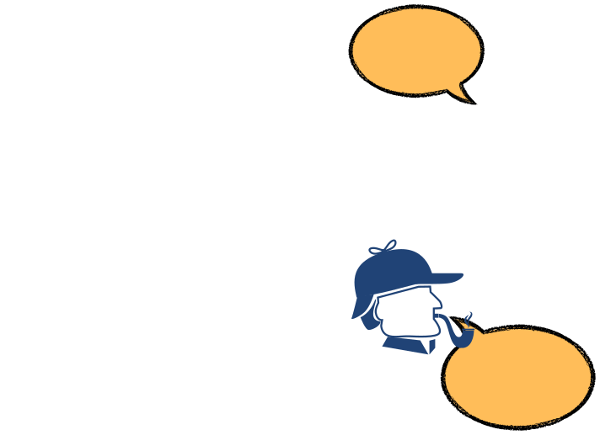



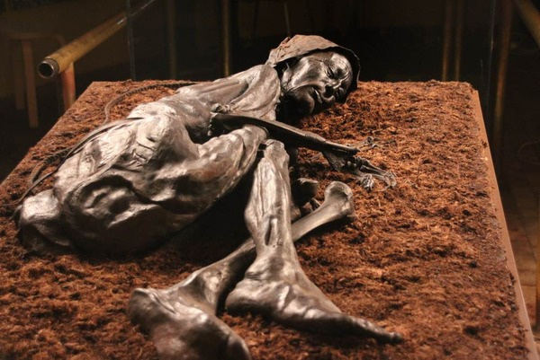
We have breaking news.
A body has been found in a swamp. Police are baffled
We need your help to solve this mystery.

Slide 12
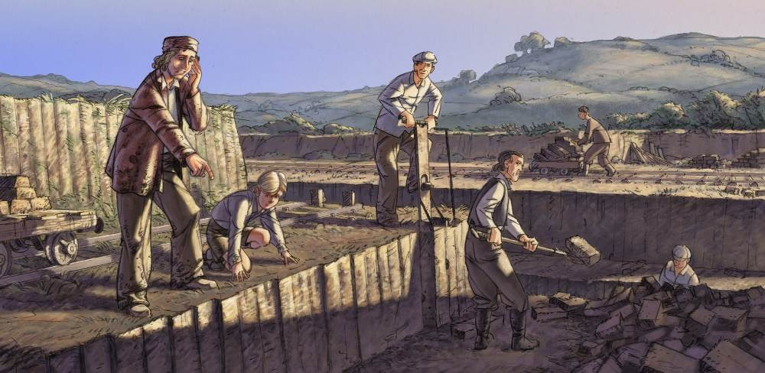
In May 1950, a body was discovered in a peat bog on Denmark's Tollund Fen. Two men were digging for peat to burn. As they worked, they noticed a face in the peat layer that looked so fresh that they thought they had discovered a recent murder.

Slide 13
THE BODY
The men carefully removed the peat from the body, revealing more of him. The man lay on his right side, as if sleeping.
He wore no clothes but a pointed skin cap and a smooth hide belt. A rope noose and an iron neck ring were wrapped around the victim's neck. It was tightly wrapped around his neck and throat.

Slide 14
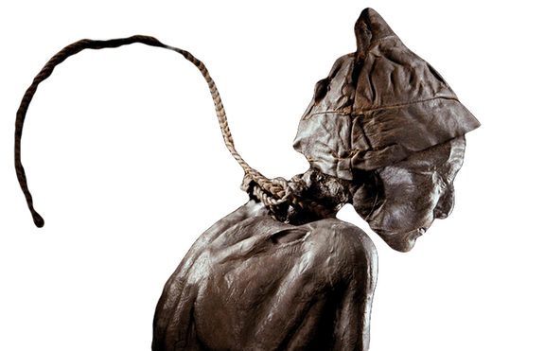
Looking for evidence...
A rope noose and a neck ring
were found on the body.
Evidence 1
Iron Age people buried neck rings with their dead as an offering to the Spring Goddess.
Evidence 2
The German trib es hang traitors from trees and drown cowards in fens under piles of sticks.
Neck rings made of rope and of iron.

Slide 15

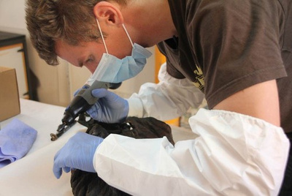

What other evidence has been found?
Age
The heart and organs were healthy. The wisdom teeth had grown. These appear in people around 20 years of age.
Stomach
The man had eaten soup at least 12 hrs
before he died. The soup was made up of
seeds that were connected only with the
Spring
DNA samples taken from Tollund Man
Under the body
When they dug the grave some plants were
trapped under the body. They were about
2000 years old.

Slide 16
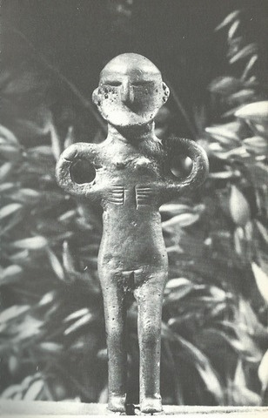
What other evidence has been found?
Statue
Near the body was discovered a statue of an Earth goddess. It symbolises Spring.
The Goddess of Spring is revered by the German tribes.
Every Spring, a cart pulls a statue of the Goddess through the streets in a procession. Slaves wash the cart and statue after that, and the slaves are sacrificed.
Earth goddess of spring statue found in the bog.

Slide 17

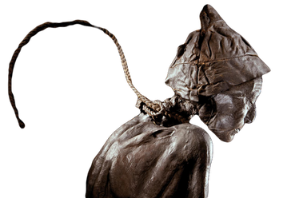

Think and share
write down on your notebook
What evidence did we find out about the Tollund Man?
Bullet point down all the evidence on your Notebook.

Slide 18
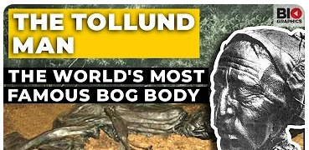
Task 1
Watch the documentary on the discovery of the Tollund Man and make notes on new information you learn.
https://www.youtube.com/watch?v=sZFZg0jyFAw
The Tollund Man: The World's Most Famous Bog Body

Slide 19

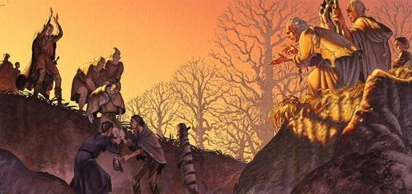
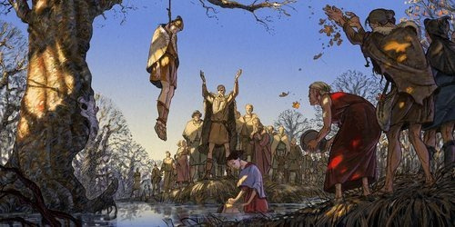

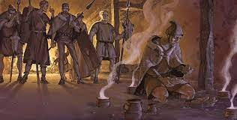
Is it a murder?
Is it a sacrifice?
The Tollund Man Mystery
Is it a punishment ?
If you had to choose one of the above reasons the Tollund Man died which one would it be? And Why? Write you ideas down on your notebook

Slide 20

Task 2
1.In pairs or on your own, read the source you have.
2.Try to pick out any evidence you can find that helps you learn what happened to the Tollund Man, and write which pieces of evidence supports each type of death that might have occurred to the Tollund Man.
3.You will have 6 minutes per sheet – you will be swapping with the next sheet afterwards.
4.Decide what you think has happened to the Tollund Man.
5.What evidence supports your view and, why does it? Write a detailed explanation in your notebook.

Slide 21
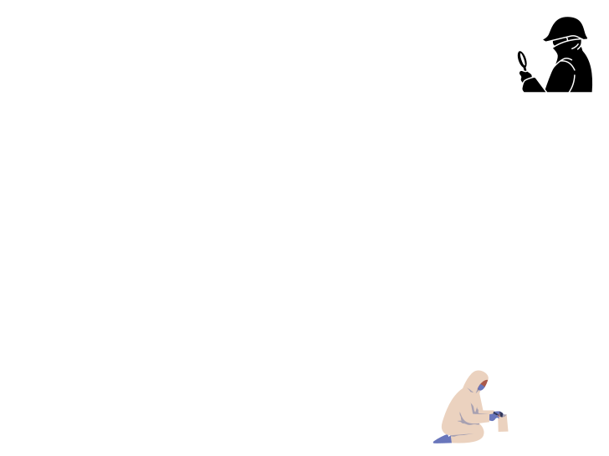



Your answer should look like this:
Based on our findings, we believe the Tollund man died as a result of...
We were able to come to this conclusion because...
Another piece of evidence supporting this is...

Slide 22

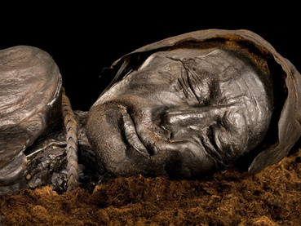
Plenary – Explain your evidence to somebody at home.
You will need to discuss the decision your made about what happened to the Tollund man.
Sacrifice?
Murder?

Slide 23
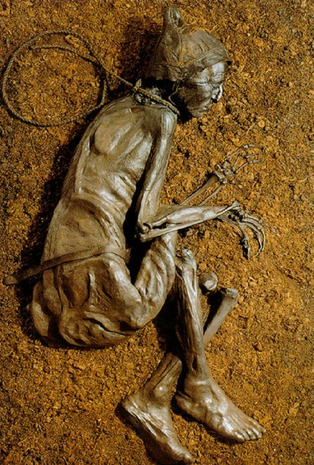
This image depicts the body discovered in a peat bog on Denmark's Tollund Fen in May 1950. Peat was being dug for burning by two men. As they continued to work, they unexpectedly noticed a face in the peat layer that was so new that believed they had discovered a recent murder. They made a police report. To reveal more of him, the men painstakingly scraped the peat from the body. The man appeared to be sleepy as he lied on his right side. Except for a sleek hide belt and a pointed skin cap, he was naked. Short haircut for his hair. The neck was bound with an iron neck ring and a rope noose. It was tightly wrapped around his throat and neck.
Source A

Slide 24
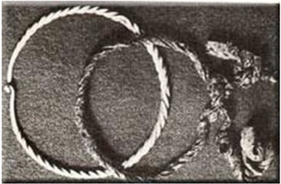
These items were found around Tollund Man's neck.
The items are a rope noose and a neck ring. Iron Age people buried neck rings with their dead as an offering to the Spring Goddess.
Source cSource B
Age: The heart and organs were healthy. The wisdom teeth had grown. These appear in people around 20 years of age. Stomach: The man had eaten soup at least 12 hrs before he died. The soup was made up of seeds that were connected only with the Spring DOD: When they dug the grave some plants were trapped under the body. They were about 2000 years old.
Forensic Report 1

Slide 25
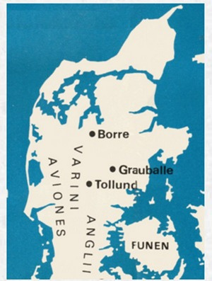
This man was found buried in a bog at Grauballe in Denmark. His throat had been cut from ear to ear. Scientists discovered that he had been buried 1650 years ago. His last meal, eaten shortly before his death, had been a vegetable soup made from Spring seeds.
Forensic Report 2
Source ESource D
Map depicting the northern German tribes who lived where Denmark is now.

Slide 26
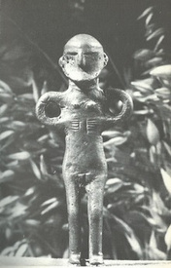
An Earth Goddess of Spring statue found in a bog.
Source GSource F
"There is nothing unusual about these tribes except their worship of Mother Earth, the Goddess of Spring. They believe that each spring she rides through the tribes. A chariot carries a statue of the Goddess in a procession. After this the chariot and her robes.....are washed clean in a hidden lake. This task is done by slaves who are then..." killed.
An exceprt (Written in 97-98 AD by Cornelius Tacitus, a Roman, in his book about the German tribes).

Slide 27
THINK LIKE A MUSLIM HISTORIAN
Imam Nawawi (Allah have mercy on him) mentions several etiquettes relating to fatwa (issuing rulings): one of them is: "He does not omit to seal his answers by saying "Allah knows best", "And God grants success". As Muslim historians when we try to unreveal the Mystery of the past we should take an example in the manners of our great Muslim scholars in their humbleness, and Adabs (manners) when seeking knowledge. Saying “Allah knows best” does not inspire or entail doubt about the ruling, for our case about the historical evidence ; instead, even if the scholar was correct, there is no scholar except that Allah, Most High, is more knowledgeable than him.
Excerpt from: "introduction to Al-Majmu’: “Al- Saymari [He is Abu Al-Qasim, one of the great
Source H
Shafi‘i scholars, died in 405 AH]
&
Quran 12:76
But above those ranking in knowledge is the One All- Knowing.[Quran, 12:76]
So as history detectives, whatever conclusion we reach, we know that only Allah swt detains the
absolute Knowledge, because:
Allah Knows Best

Slide 28
